Slide 1
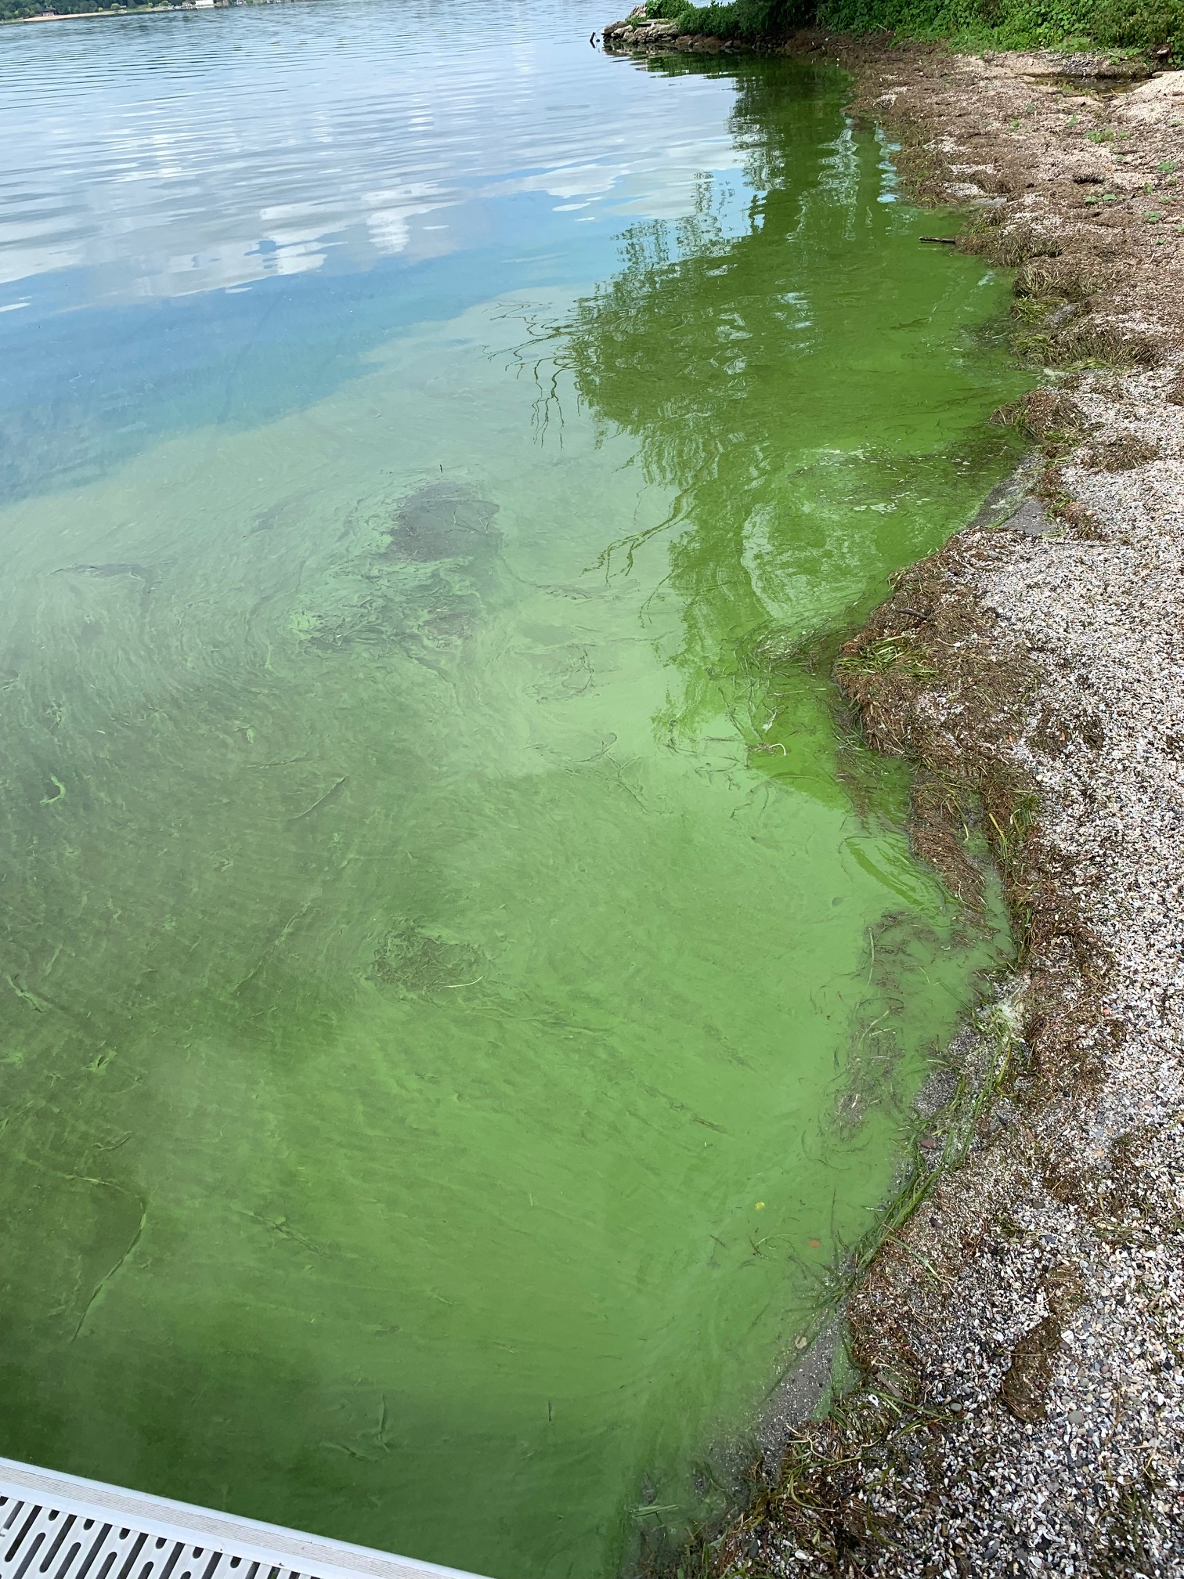

Monitoring HABs on Cayuga Lake
Grace Haynes
Outreach and Programs Coordinator
Cayuga Lake HABs Monitoring Program Coordinator
Community Science Institute (CSI)
Photo by Holly Davidson, CSI HABs volunteer
Notes:
Raise your hand if you've been a HABs harrier before!

Slide 2
Certified Water
Testing Lab
ELAP #11790
Volunteer Water Monitoring Programs
Public Water Quality Database
Red Flag Monthly
Stream Monitoring
Synoptic Stream & Lake Monitoring
Nonprofit
501(c)3
Organization
Outreach and Education
Cayuga Lake HABs Monitoring
Biomonitoring (BMI Monitoring)
Community Science Institute’s Mission
To empower community members to protect water through volunteer stream and lake monitoring
Notes:
For those of you who don’t know, Community Science Institute is a local environmental nonprofit focused on water quality in the finger lakes region.
We’re a registered 501(c)3 nonprofit organization and a state-certified water testing lab—that means our results are regulatory quality; it means they would hold up in court and it means that we follow very specific lab protocols and procedures – as we get into some of the particulars of collecting samples, those rules often are in place because we want our results to be certified, AKA regulatory quality
A lot of the water we test comes from our 4 volunteer water monitoring programs:
Synoptic Stream and Lake Monitoring, where a group of volunteers takes samples from all along a creek on the same day and then sends those samples to our lab for analysis
The Cayuga Lake HABs Monitoring Program, which I’ll get into more detail about later but which monitors HABs on Cayuga Lake
Our Biomonitoring Program, where volunteers collect organisms from streams to learn about water quality
And our Red Flag Monitoring Program, where volunteers test water chemistry streamside
Once we have the results from all these programs, we store them in our free, public water quality database online for anyone to look at and learn from
And then we do outreach and education to our community—things like free children’s programming or this talk I’m doing here right now.

Slide 3
Certified Water
Testing Lab
ELAP #11790
Volunteer Water Monitoring Programs
Public Water Quality Database
Red Flag Monthly
Stream Monitoring
Synoptic Stream & Lake Monitoring
Nonprofit
501(c)3
Organization
Outreach and Education
Cayuga Lake HABs Monitoring
Biomonitoring (BMI Monitoring)
Community Science Institute’s Mission
To empower community members to protect water through volunteer stream and lake monitoring
Notes:
So as I mentioned, I’m the coordinator of the Cayuga Lake HABs Monitoring Program, and that’s what I’m here today to focus on: HABs on Cayuga Lake.

Slide 4
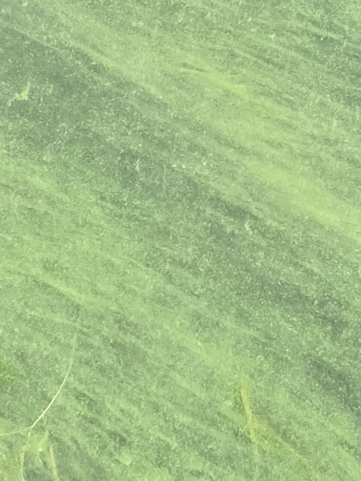
Three Part Training
1. What is a “harmful algal bloom”?
Cyanobacteria and HABs ecology
3. Reporting HABs
CSI’s Cayuga Lake HABs Monitoring Program
Volunteer duties
2. Identifying HABs
Things that are NOT HABs
Impacts of freshwater HABs
Things that ARE HABs
Photo by Jeanne Sullivan, CSI HABs volunteer

Slide 5
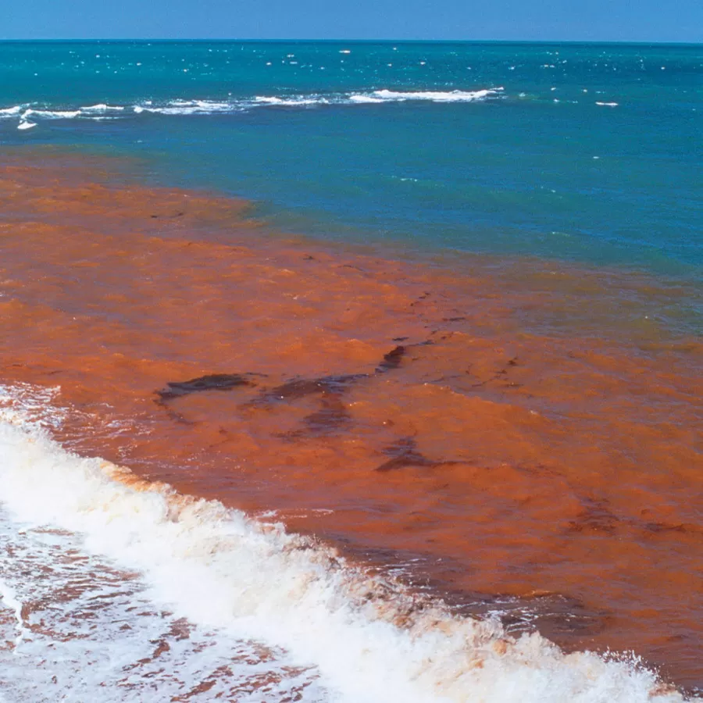
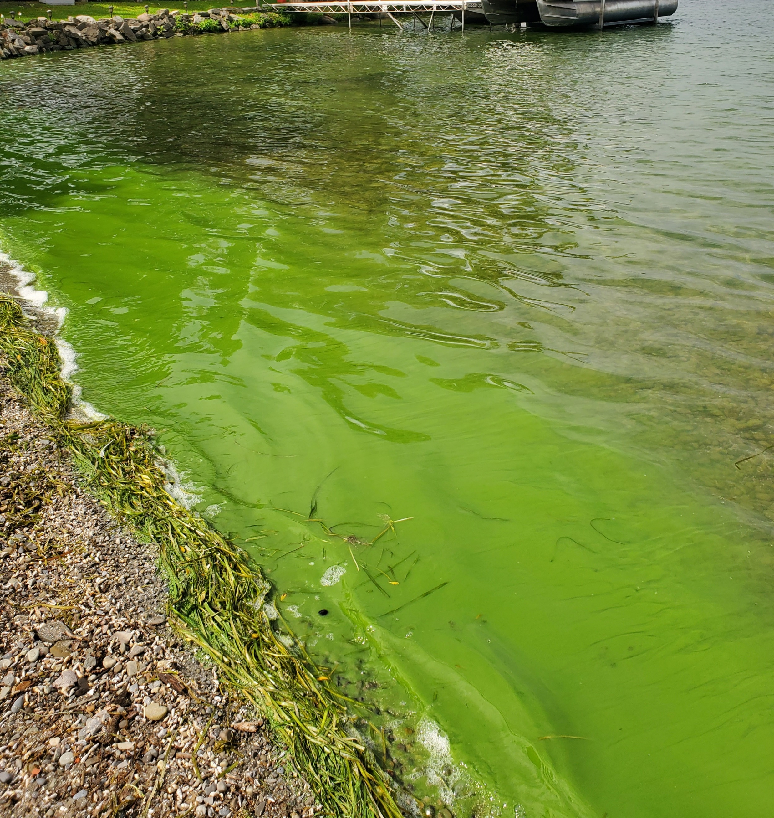
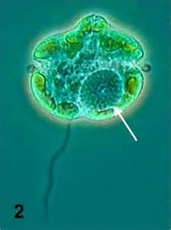
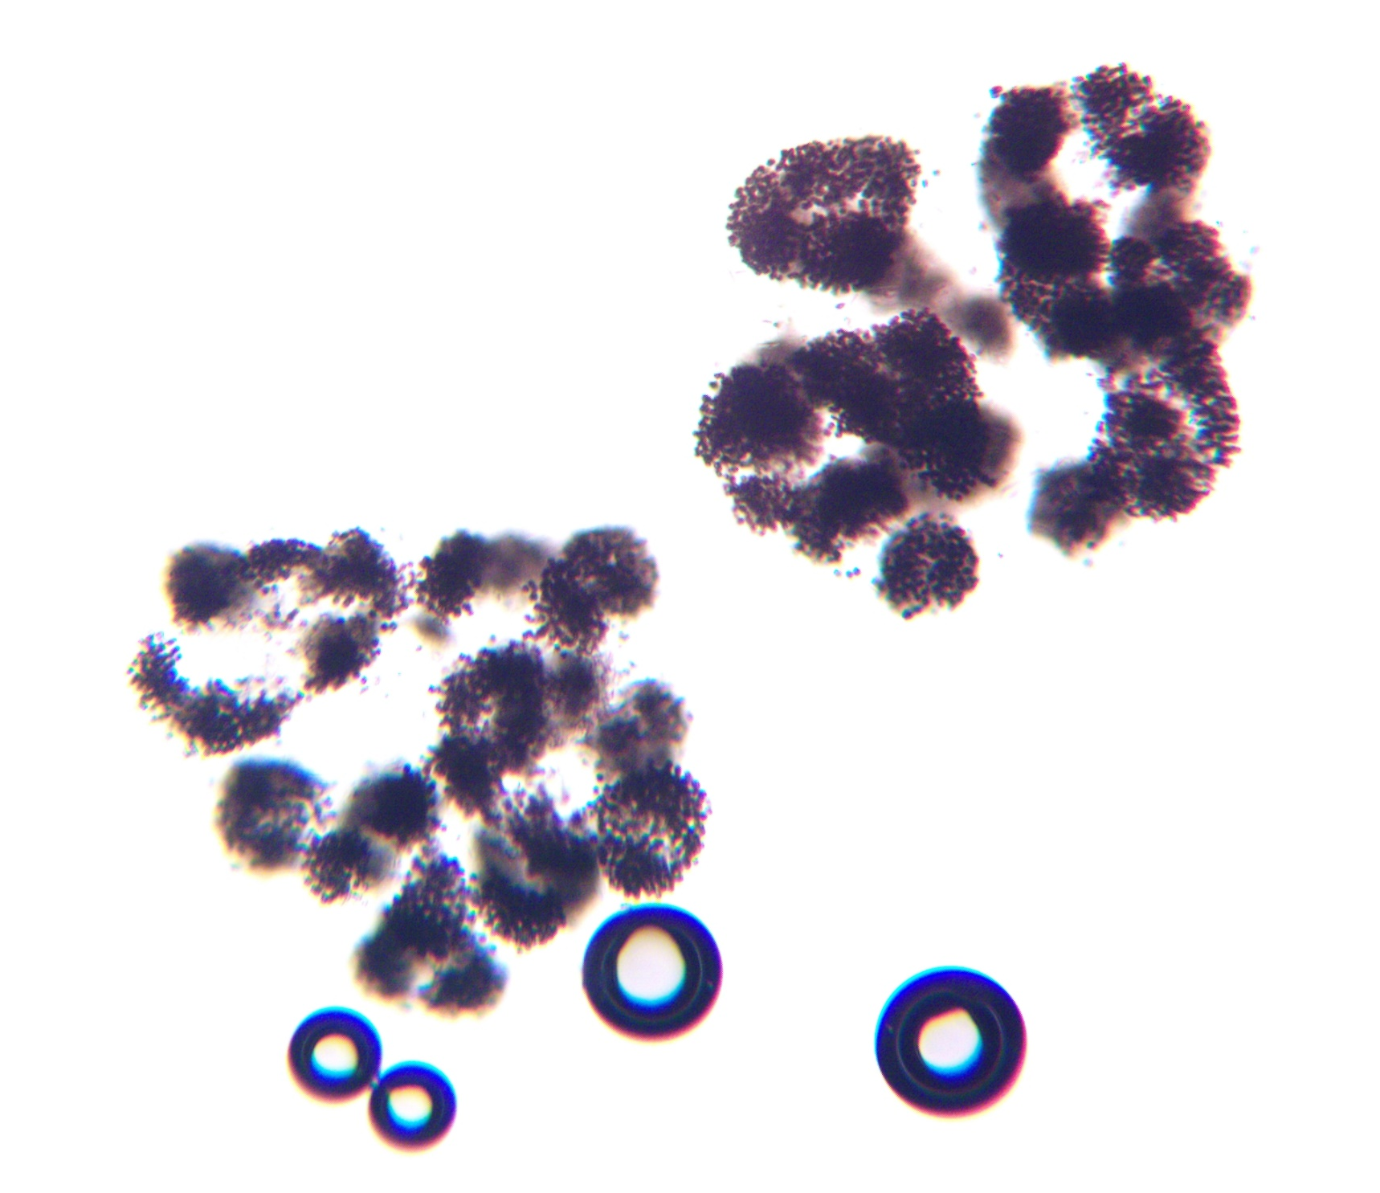
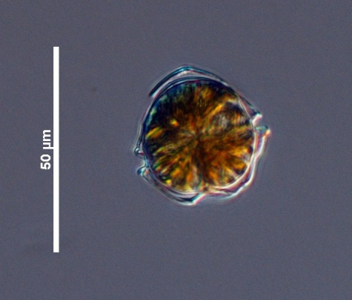
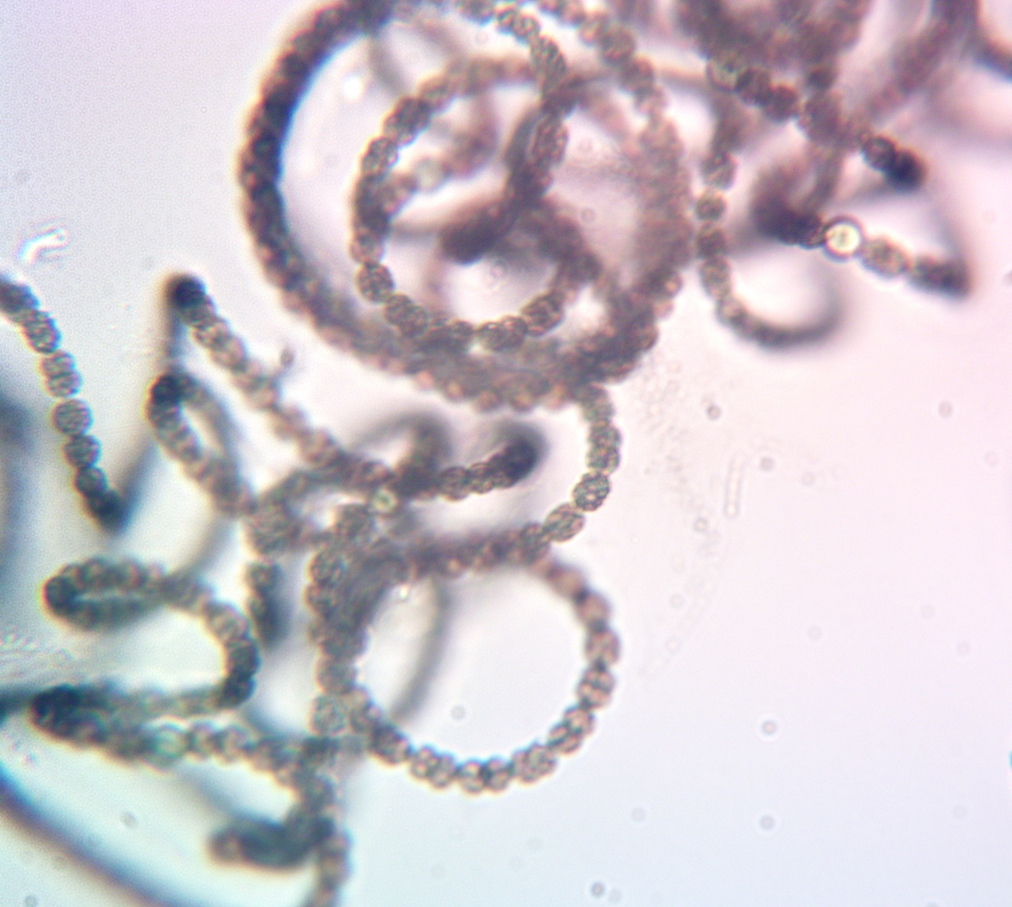

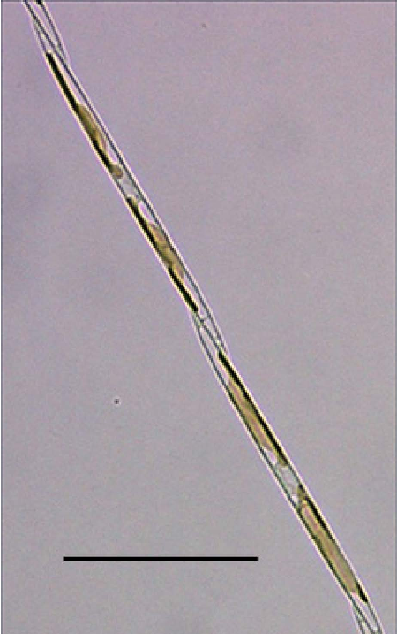
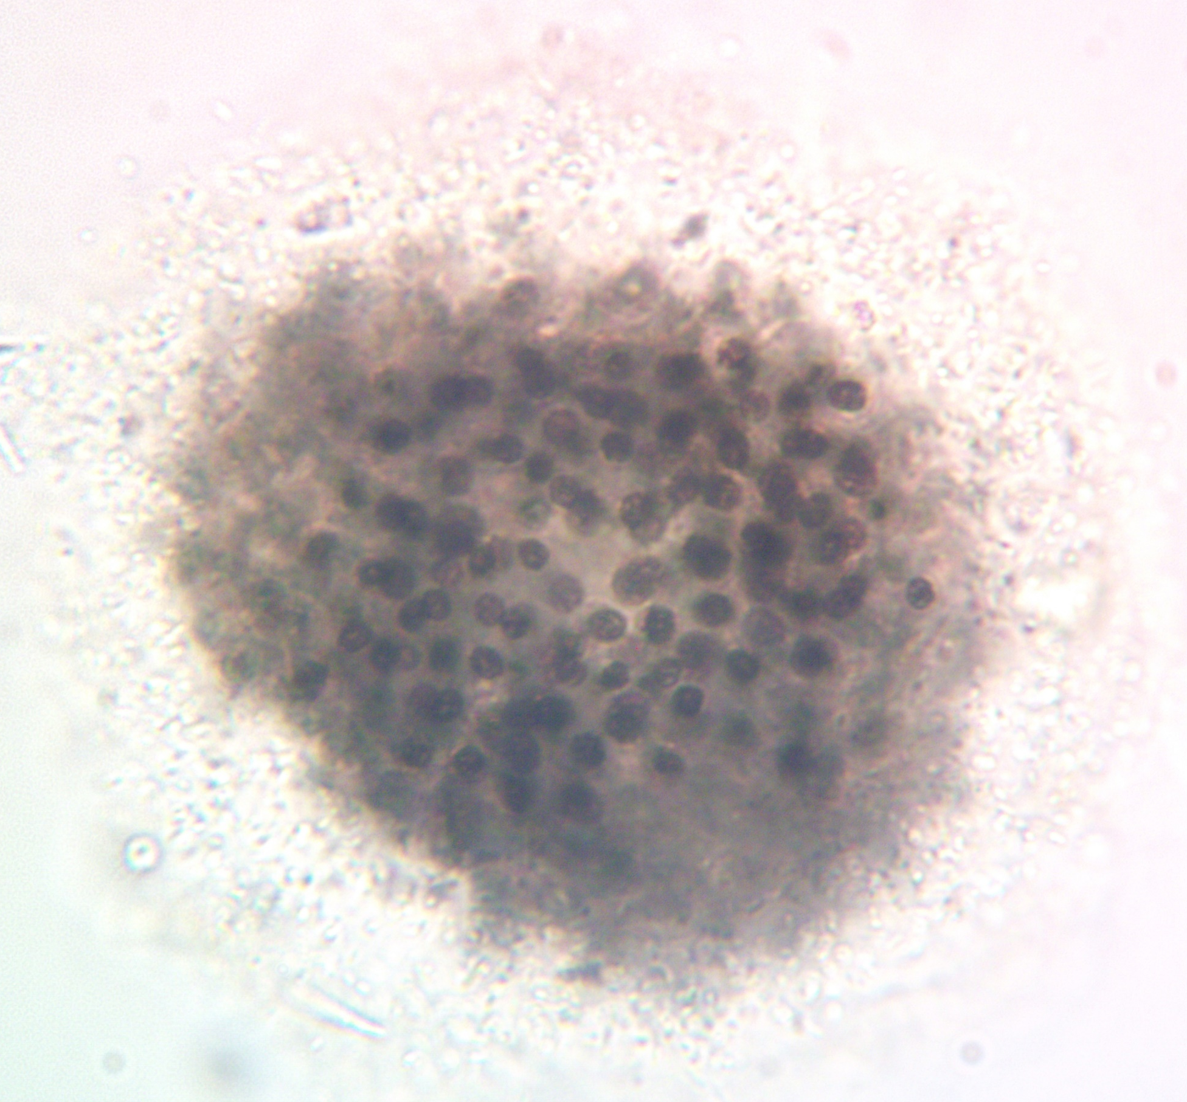
What is a “Harmful Algal Bloom”?
“Harmful algal bloom” is largely a misnomer!
Marine “harmful algal blooms”
Aka “red tides”
Freshwater “harmful algal blooms”
Dinoflagellates
Photo by Flickr User AJC1
Diatoms
Photo by Joni Dropkin, CSI HABs volunteer
What is a Harmful Algal Bloom?
Reporting HABs
Identifying HABs
Notes:
-Refers to an enormous range of phenomena
-Oceans—often phytoplankton, diatoms, dinoflagellates
-Red tides (dinoflagellates)
-These are a huge problem
-A lot of broader investigation focuses on these types of blooms
-Fresh water—cyanobacteria (are there other things too?)
-But those aren't what we monitor on Cayuga Lake – can anyone tell me what Freshwater HABs are made of?

Slide 6
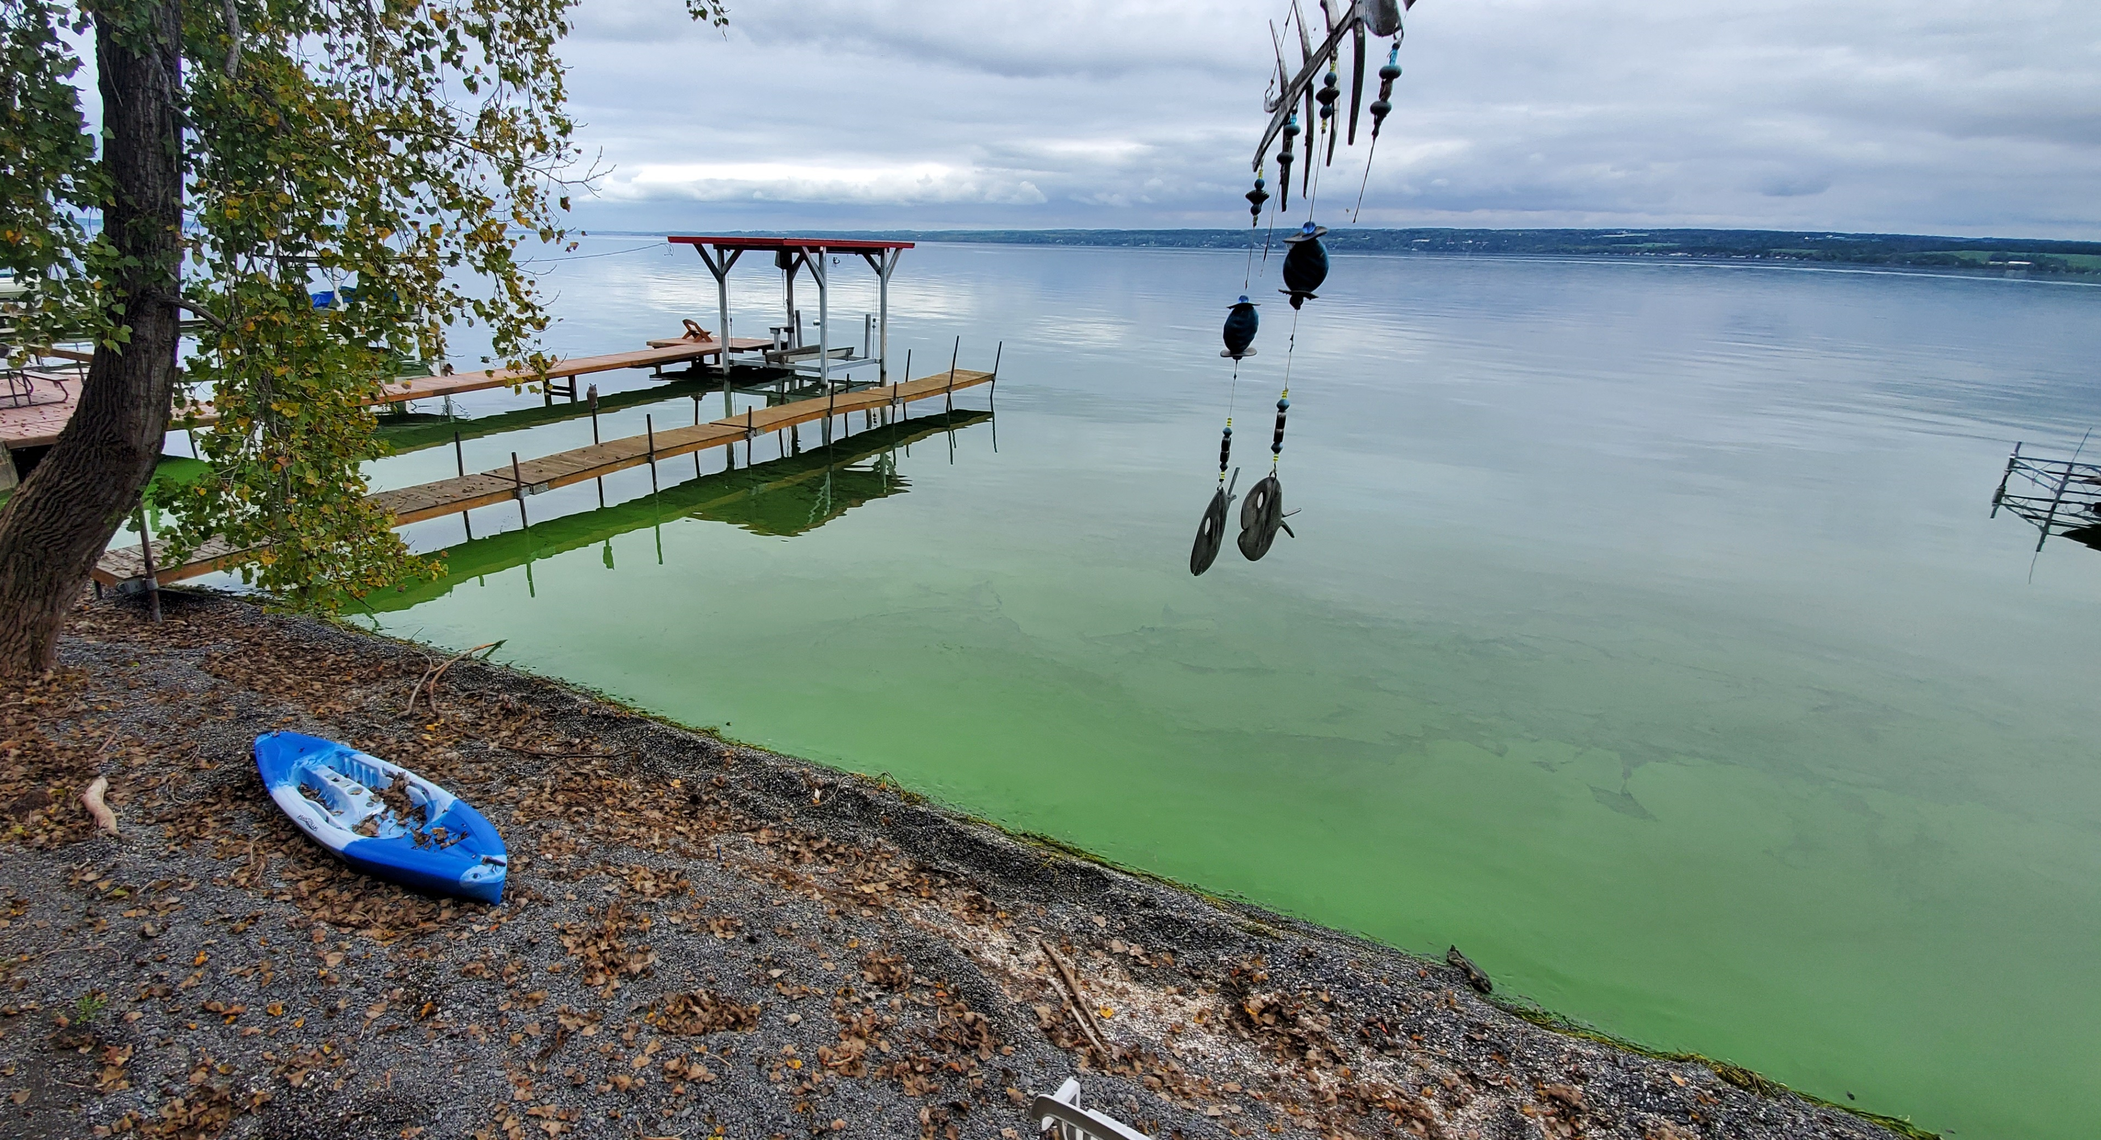
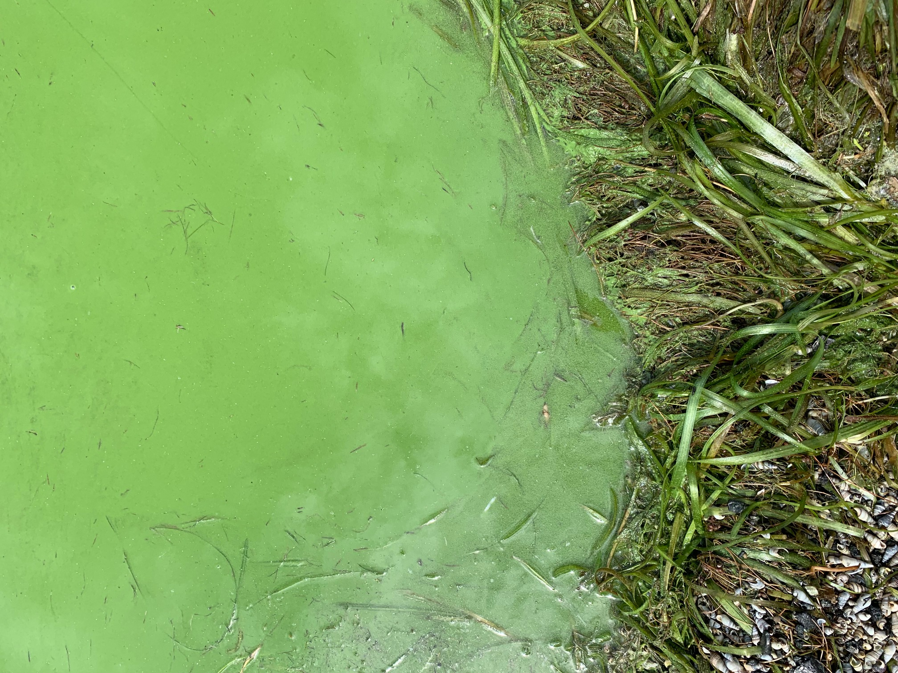
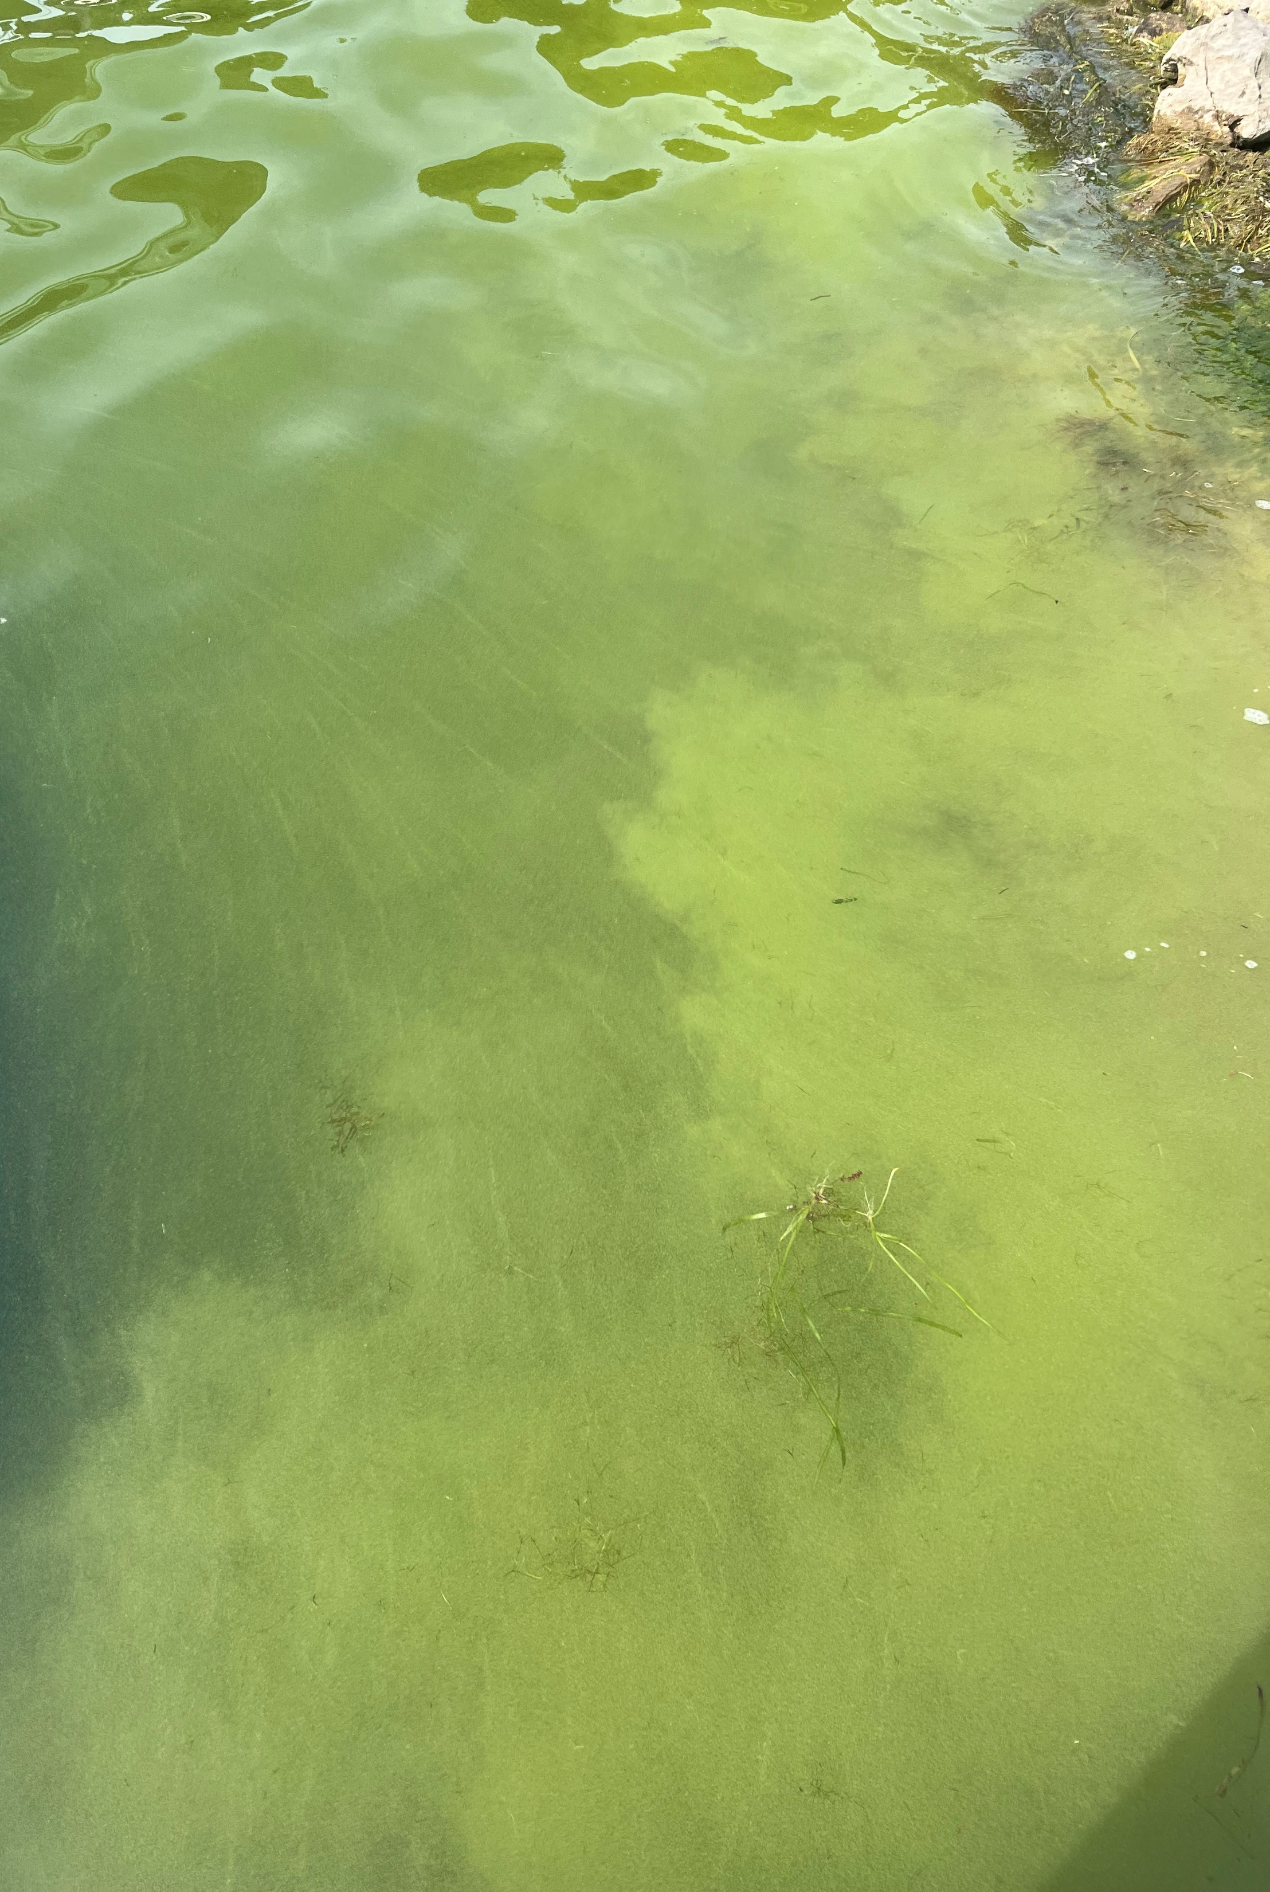
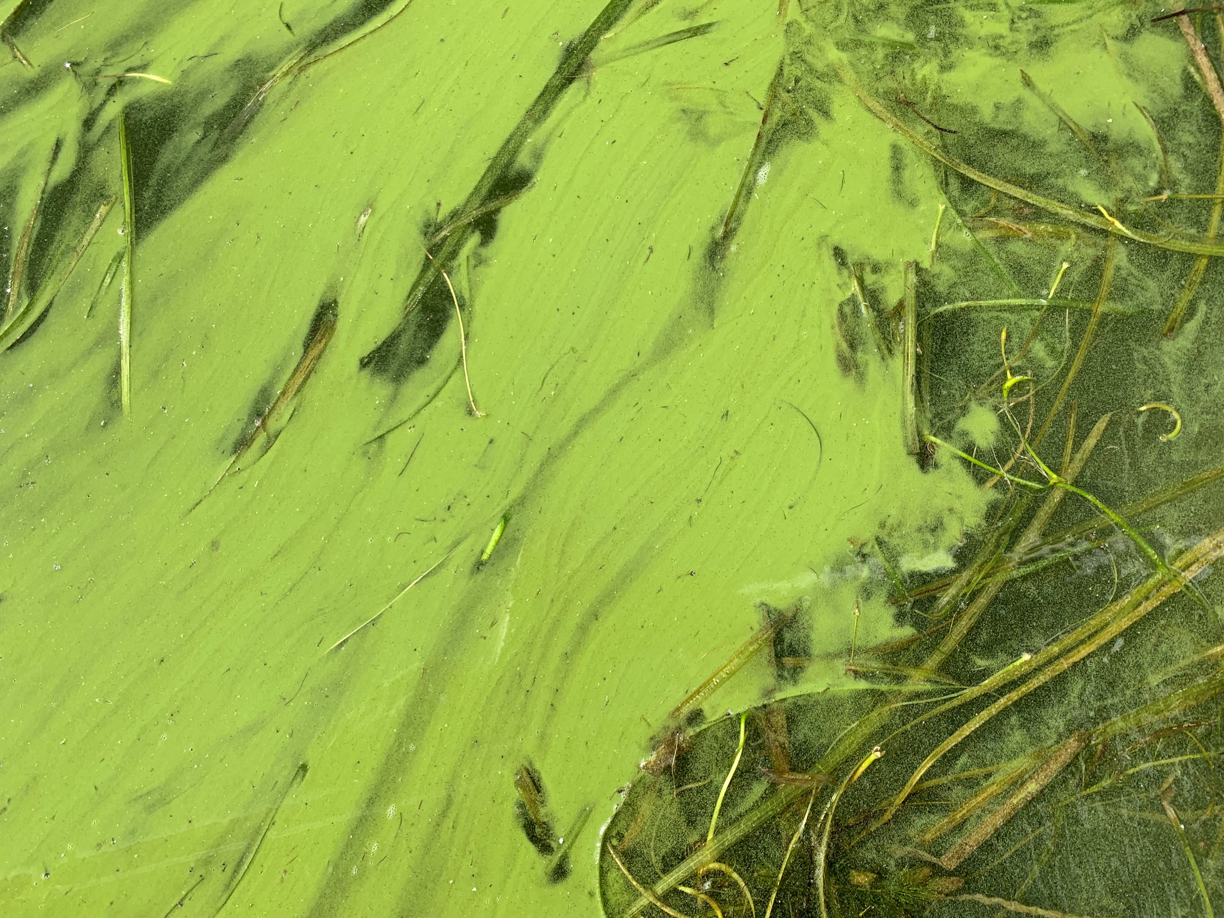
What is a “Harmful Algal Bloom”?
freshwater
^
Cyanobacteria
Photo by Ken Riemer, CSI HABs volunteer
Photos by Holly Davidson and Joni Dropkin, CSI HABs volunteers
What is a Harmful Algal Bloom?
Reporting HABs
Identifying HABs
Notes:
Yes! They are cyanobacteria! So in a freshwater ecosystem, what we call a "Harmful Algal Bloom" generally does not even refer to algae!
Cyanobacteria can be referred to a blue-green algae, but they are a different organism. But we do still call them HABs because it's broadly how they're known.

Slide 7
What are cyanobacteria?
What is a Harmful Algal Bloom?
Reporting HABs
Identifying HABs
Notes:
So let's take a step back. Before we can really talk about freshwater HABs, I want you to all understand cyanobacteria on their own, the things that make up these HABs. Cyanobacteria are organisms that were hugely important in the history of life on Earth long before we started thinking about HABs, long before we even existed. Let’s talk about where they come from. So I’m going to start by giving you a little history lesson.

Slide 8
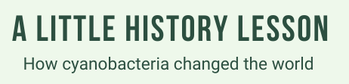

~4.5B YEARS AGO
What is a Harmful Algal Bloom?
Reporting HABs
Identifying HABs
Notes:
Cyanobacteria were critical to the formation of the Earth as we know it!
~4.5b years ago – Earth is formed

Slide 9

~4.5B
~3.8B YEARS AGO
What is a Harmful Algal Bloom?
Reporting HABs
Identifying HABs
Notes:
~3.8b years ago – 1st life on earth
No O2 in Earth’s atmosphere – instead, most of it is methane
All life is “anaerobic,” meaning it doesn’t need oxygen to survive
Any guesses about when approximately cyanobacteria evolved for the first time?

Slide 10
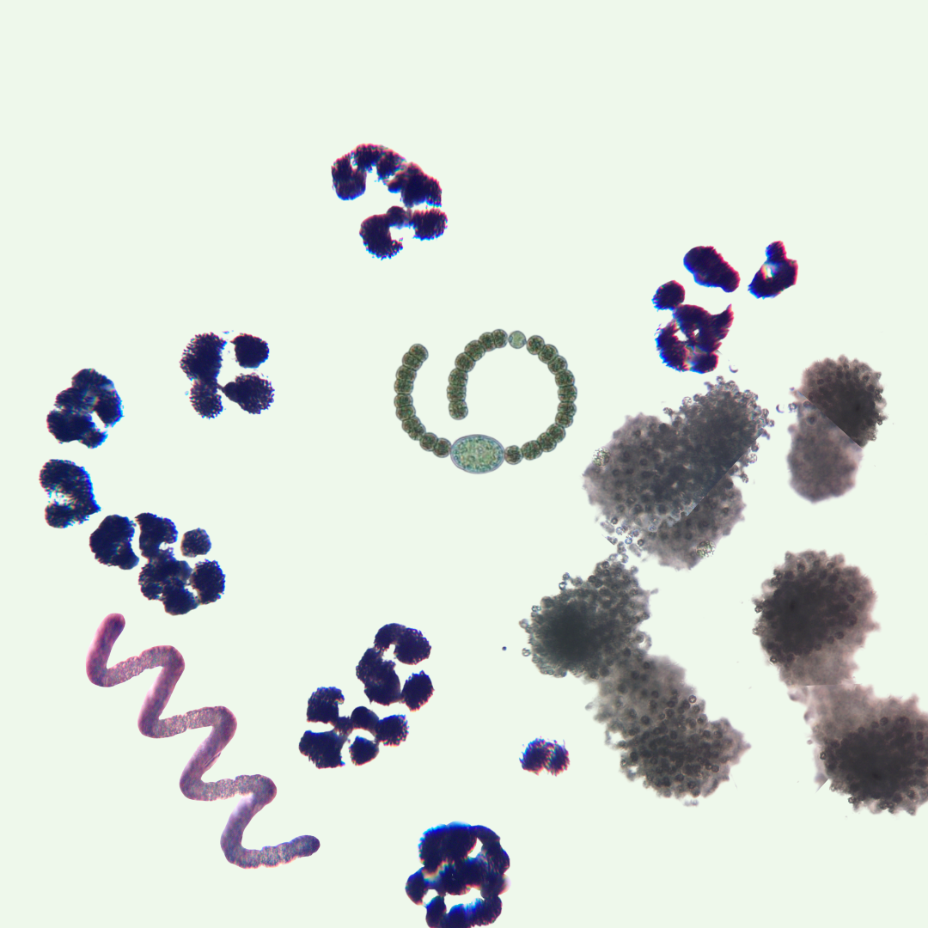
~2.7B YEARS AGO
~4.5B
~3.8B
What is a Harmful Algal Bloom?
Reporting HABs
Identifying HABs
Notes:
2.7b years ago – cyanobacteria evolve
Invent photosynthesis
generate energy from sunlight!
Use water as a fuel source
Most importantly, the by-product of photosynthesis is oxygen

Slide 11
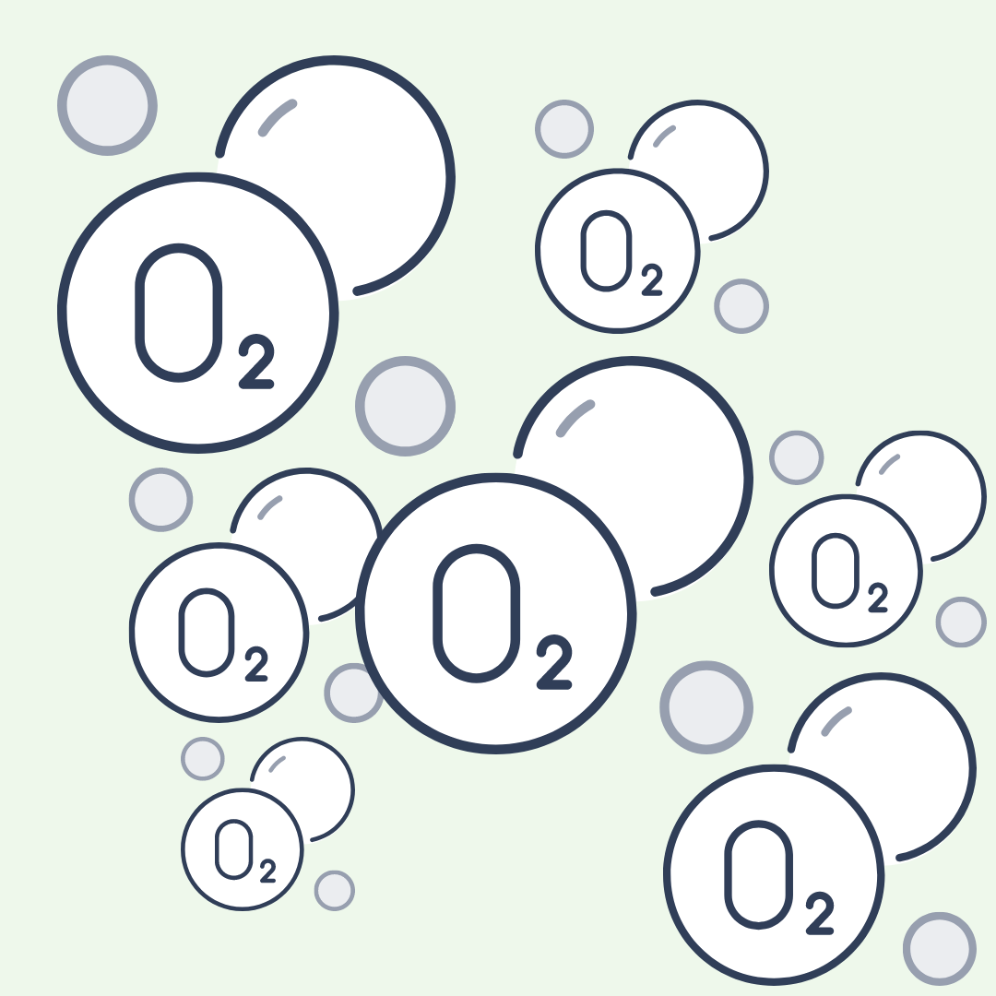
~4.5B
~2.7B
~3.8B
~2.4 - 2.1B YEARS AGO
What is a Harmful Algal Bloom?
Reporting HABs
Identifying HABs
Notes:
2.4-2.1b years ago – the Great Oxidation Event
Cyanobacteria gradually increase O2 levels in the ocean, it also escapes to the air and replaces the methane
This has radical climate effects on Earth, ultimately leading to widespread death of a lot of anaerobic life, and alongside that the evolution of aerobic life (life that needs oxygen).

Slide 12
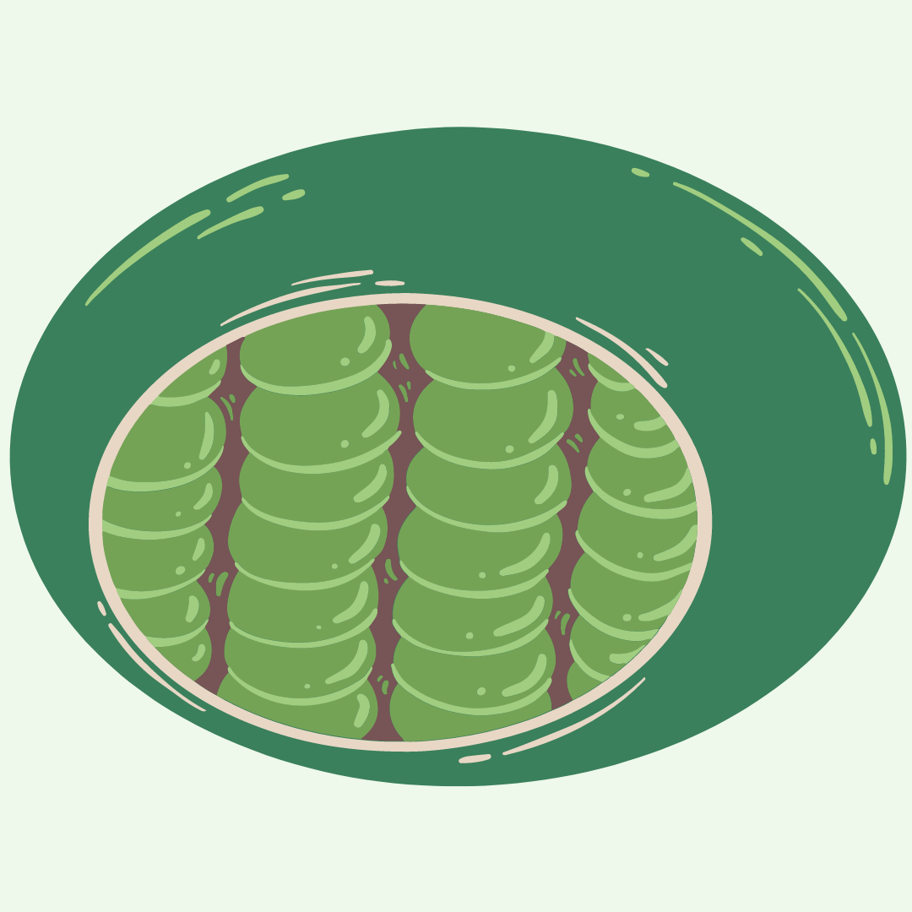
>1B YEARS AGO
~4.5B
~2.7B
~3.8B
~2.4 - 2.1B
What is a Harmful Algal Bloom?
Reporting HABs
Identifying HABs
Notes:
>1b years ago – organelles evolve, including chloroplasts
A fun fact is that cyanobacteria were absorbed into plant cells and became the part of the cell that does photosynthesis, called the chloroplast
This makes sense, right? HABs are green because cyanobacteria are green, plants are green because cyanobacteria are green, chloroplasts are the things that make plants green!

Slide 13
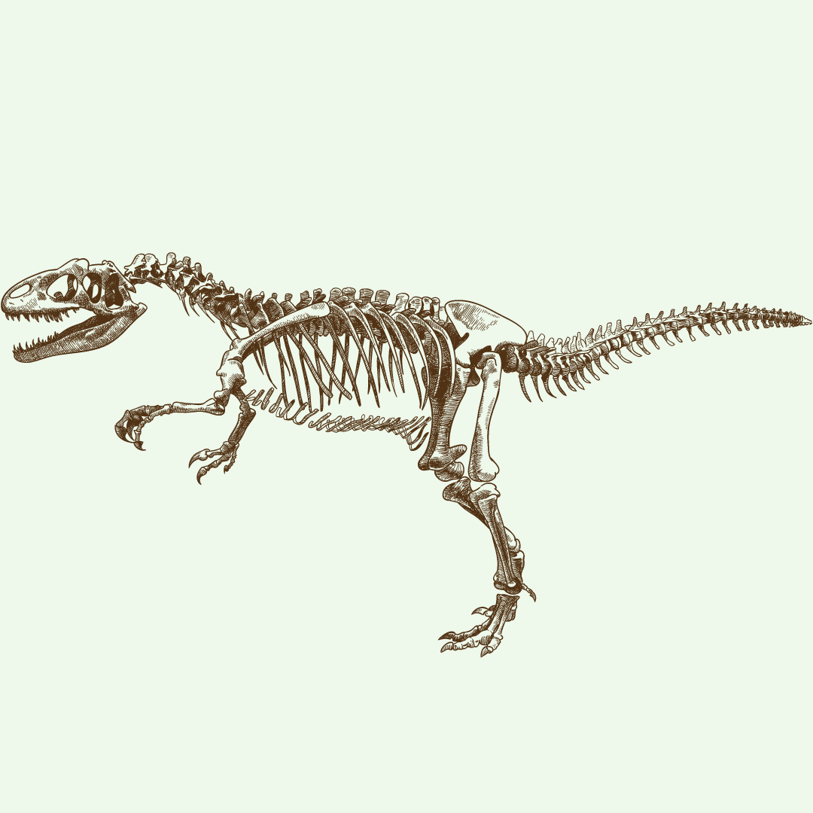
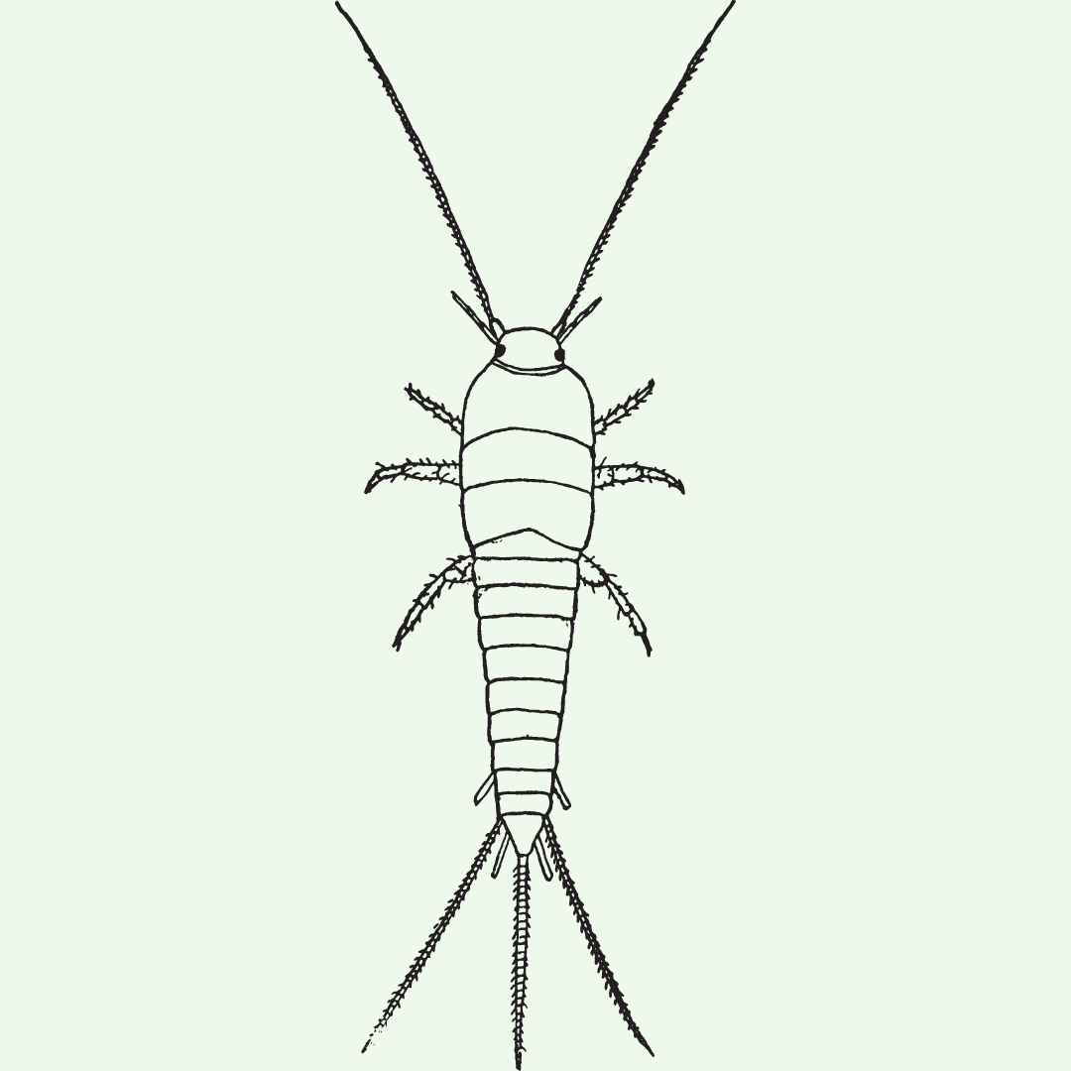

~200M YEARS AGO
~4.5B
~2.7B
>1B
~3.8B
~2.4 - 2.1B
~480M YEARS AGO
~250,000 YEARS AGO
What is a Harmful Algal Bloom?
Reporting HABs
Identifying HABs
Notes:
For some context, this is where insects evolved, where dinosaurs evolved, and where humans evolved—these events span most of the earth’s history!

Slide 14
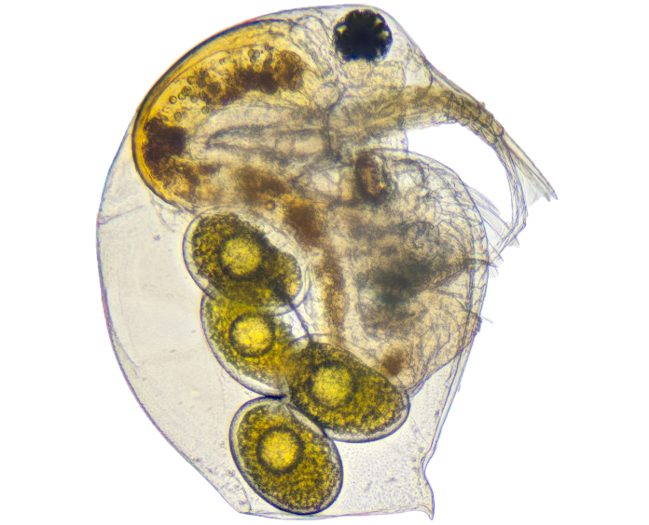
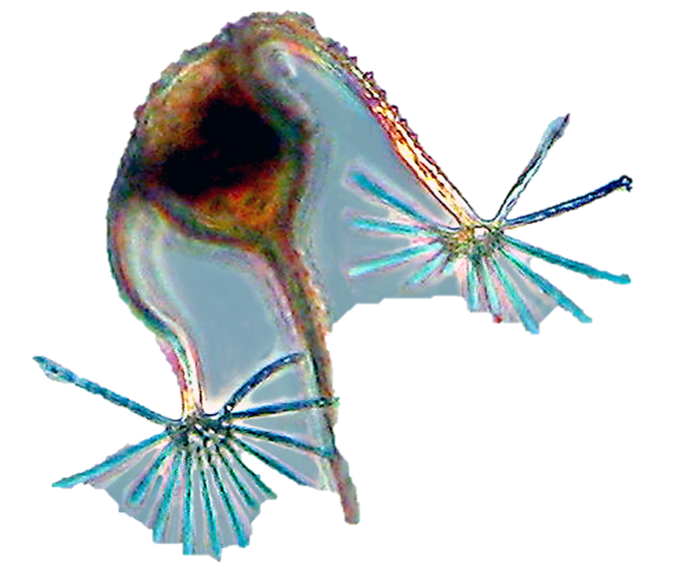
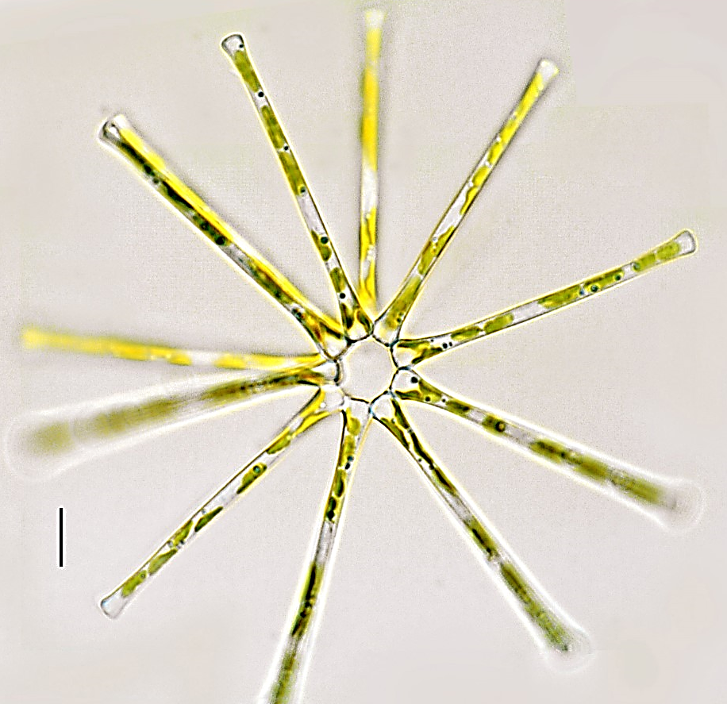
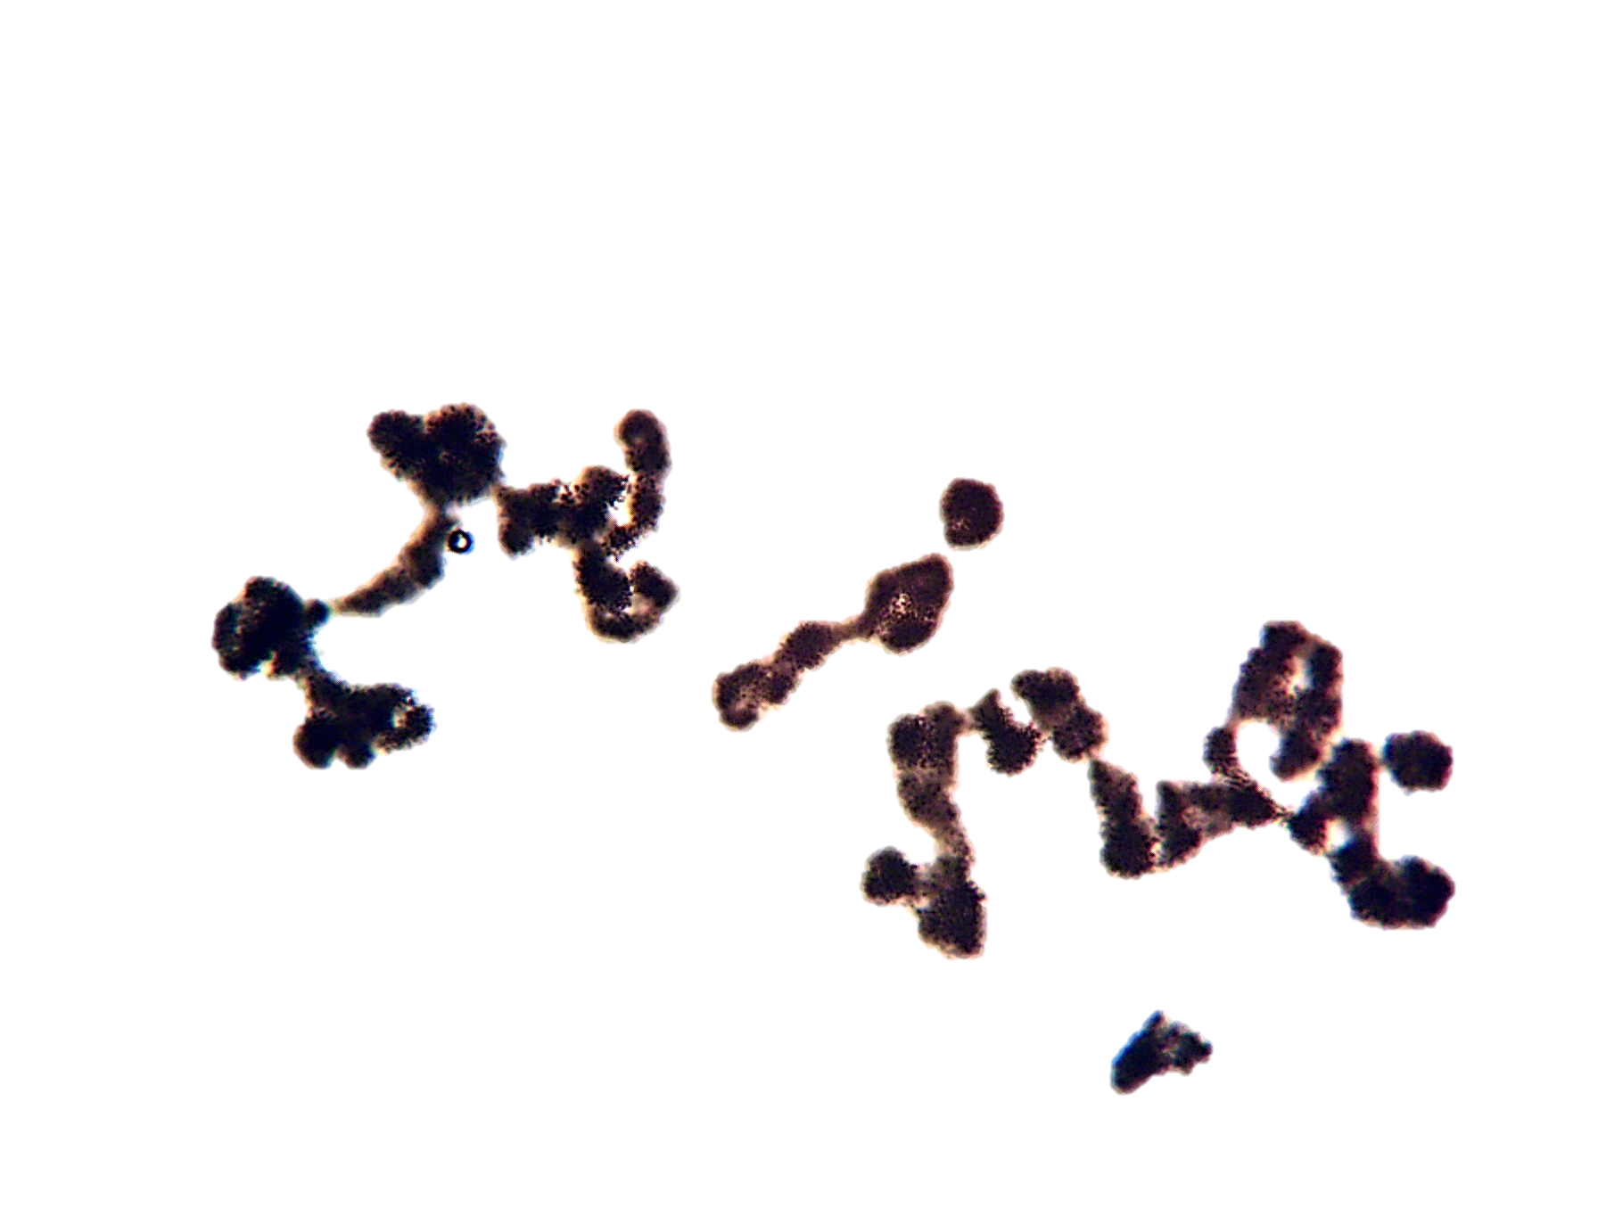
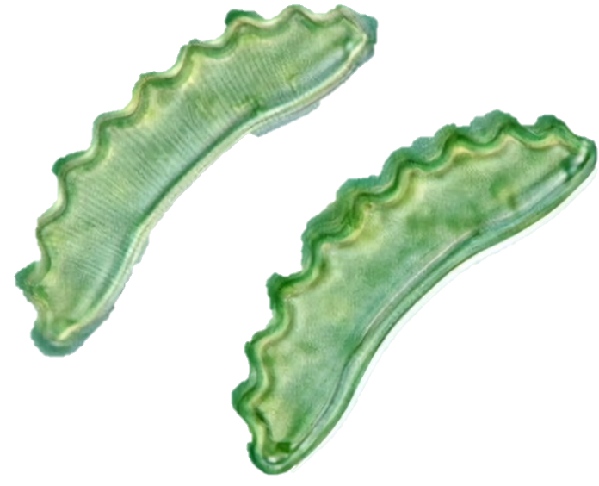
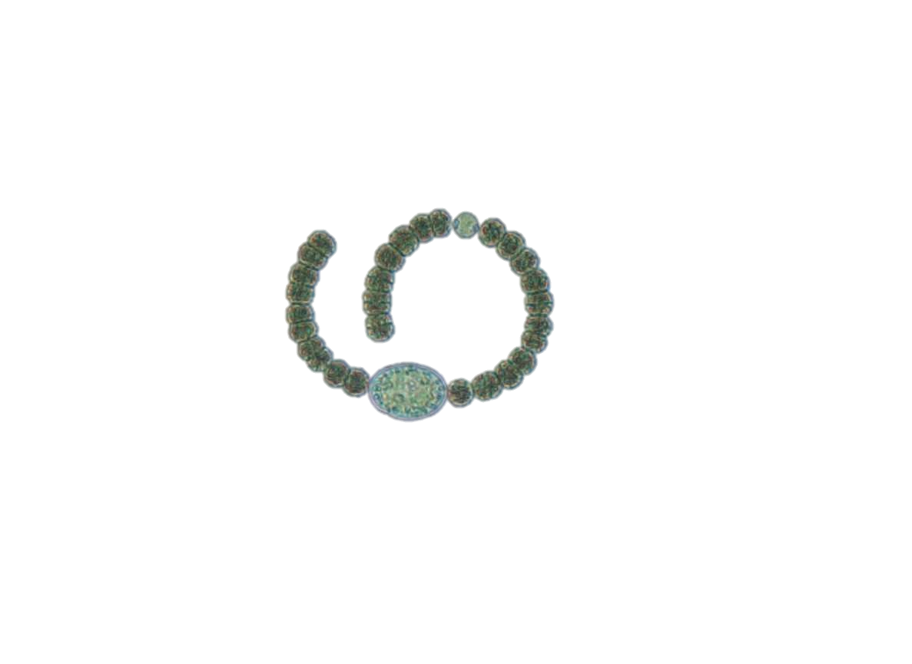
Cyanobacteria
Part of a healthy, balanced , normal freshwater ecosystem
What is a Harmful Algal Bloom?
Reporting HABs
Identifying HABs
Notes:
Cyanobacteria have this long evolutionary history where they played an important role in the environment. They still do coexist in the water with other microorganisms, even when there are no visible blooms.

Slide 15
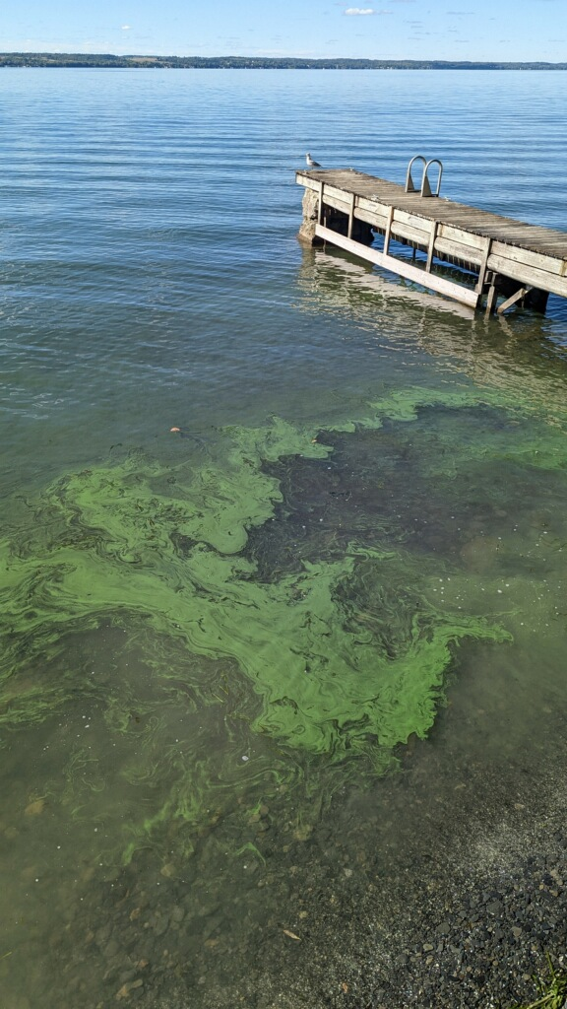

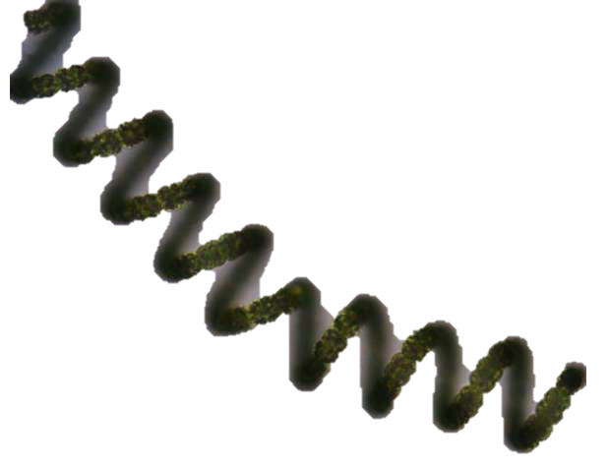
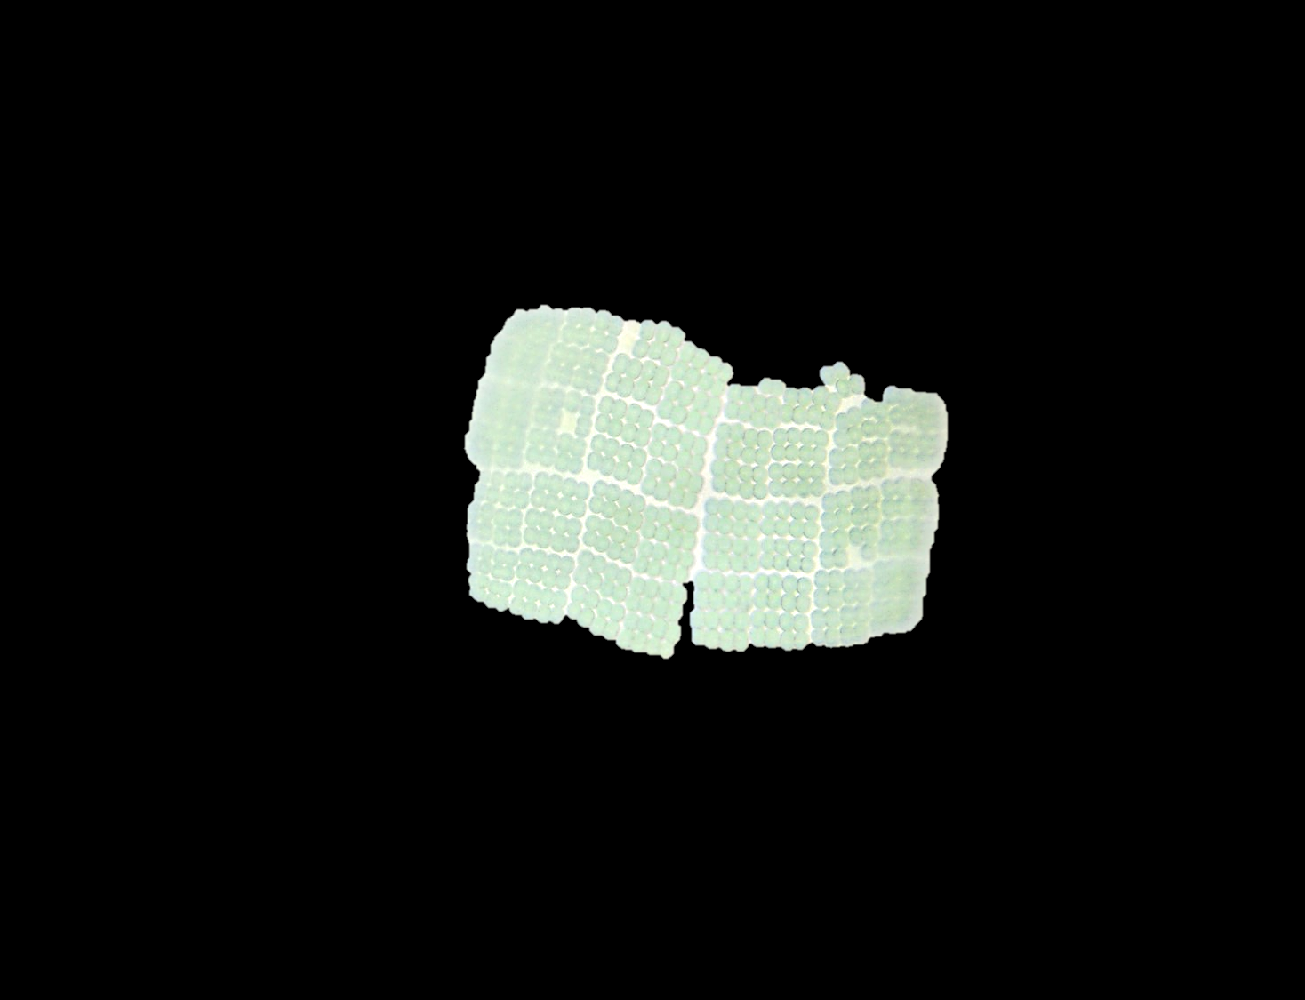
When do they become “harmful”?
A “HAB” is an explosive population growth of these cyanobacteria, which may produce toxins
Photo by Michelle Jenkins, CSI HABs volunteer
What is a Harmful Algal Bloom?
Reporting HABs
Identifying HABs
Notes:
So instead of seeing them as a small portion of microorganisms that are present, we see exclusively or almost exclusively cyanobacteria present!
A Harmful Algal Bloom is when we see an explosive growth of cyanobacteria at the top of the water. These can produce toxins – that’s what makes them “harmful”

Slide 16
Cyanobacteria produce chemical compounds
Beneficial compounds | Harmful compounds (“cyanotoxins”)
Anti-cancer drugs Anti-viral drugs (can help treat HIV) Antibacterial drugs | Liver toxins Neurotoxins
Namikoshi and Rinehart 1996, Singh et al. 2011
What is a Harmful Algal Bloom?
Reporting HABs
Identifying HABs
Notes:
Cyanobacteria produce a lot of different compounds, and not all of them are negative
Many are beneficial to humans, often used in pharmaceuticals and actively being researched for additional benefits!
Many are known to be harmful, and these are called cyanotoxins. These are often liver toxins or neurotoxins
There are also many compounds that are still not well understood
And as you may be able to guess, cyanotoxins are the main reason we get concerned about HABs—these are the compounds that have negative impacts on the things we value

Slide 17


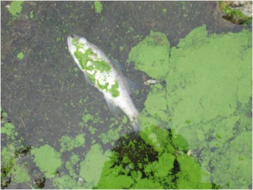
Impacts of HABs
Economic impacts
Impacts on human health
Ecological impacts
What is a Harmful Algal Bloom?
Reporting HABs
Identifying HABs
Notes:
Making contact with blooms can be dangerous – some of the compounds they produce can irritate your skin just by touching it. And some of them also produce toxins like liver or neurotoxins
That means when a bloom is present it prevents us from swimming or fishing in that water, it can contaminate drinking water sources, etc.
It also has economic impacts – real estate prices can be impacted by frequent blooms, and tourism dollars – people often vacation here, partially because of the stunning natural areas; blooms threaten that source of income to our local economy here
Blooms can also impact the lake’s ecology – they can lead to conditions without oxygen by throwing the ecosystem out of balance, and the toxins they produce can have specific impacts on individual species, too.

Slide 18
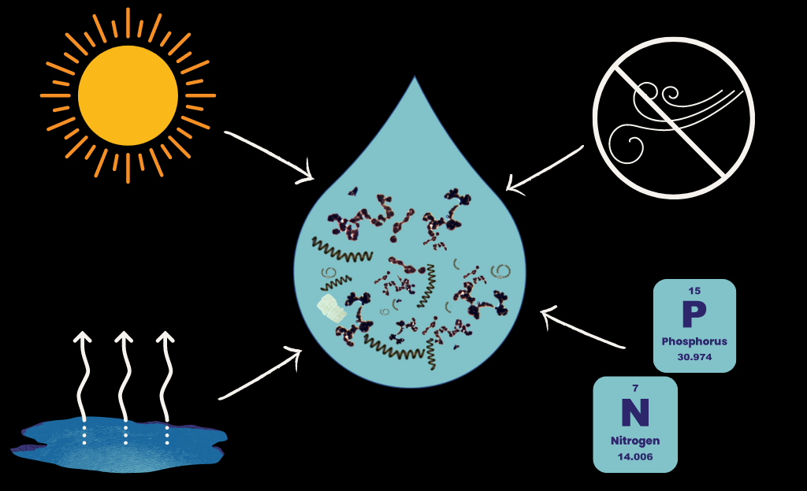
sunlight
still conditions
nutrients
increased temperature
What is a Harmful Algal Bloom?
Reporting HABs
Identifying HABs
Notes:
Finally, it’s thought that nutrient loading can contribute to HABs—nitrogen and phosphorus
these can come from many different places
Wastewater, urban runoff, industrial runoff, agricultural runoff, and also internal nutrient cycling from within the lake
Ratios, interactions with each other and other nitrogen-fixing organisms

Slide 19
What is a "HAB"?
H: Harmful
  Toxins, economic, aesthetic, ecological
A: Algal
  Freshwater HABs refer to cyanobacteria. Not true algae.
B: Bloom
  Proliferations of cells, dense concentrations
Photo by Michelle Jenkins, CSI HABs volunteer
What is a Harmful Algal Bloom?
Reporting HABs
Identifying HABs
Notes:
So instead of seeing them as a small portion of microorganisms that are present, we see exclusively or almost exclusively cyanobacteria present!
A Harmful Algal Bloom is when we see an explosive growth of cyanobacteria at the top of the water. These can produce toxins – that’s what makes them “harmful”

Slide 20

How to Identify HABs
What is a Harmful Algal Bloom?
Reporting HABs
Identifying HABs

Slide 21
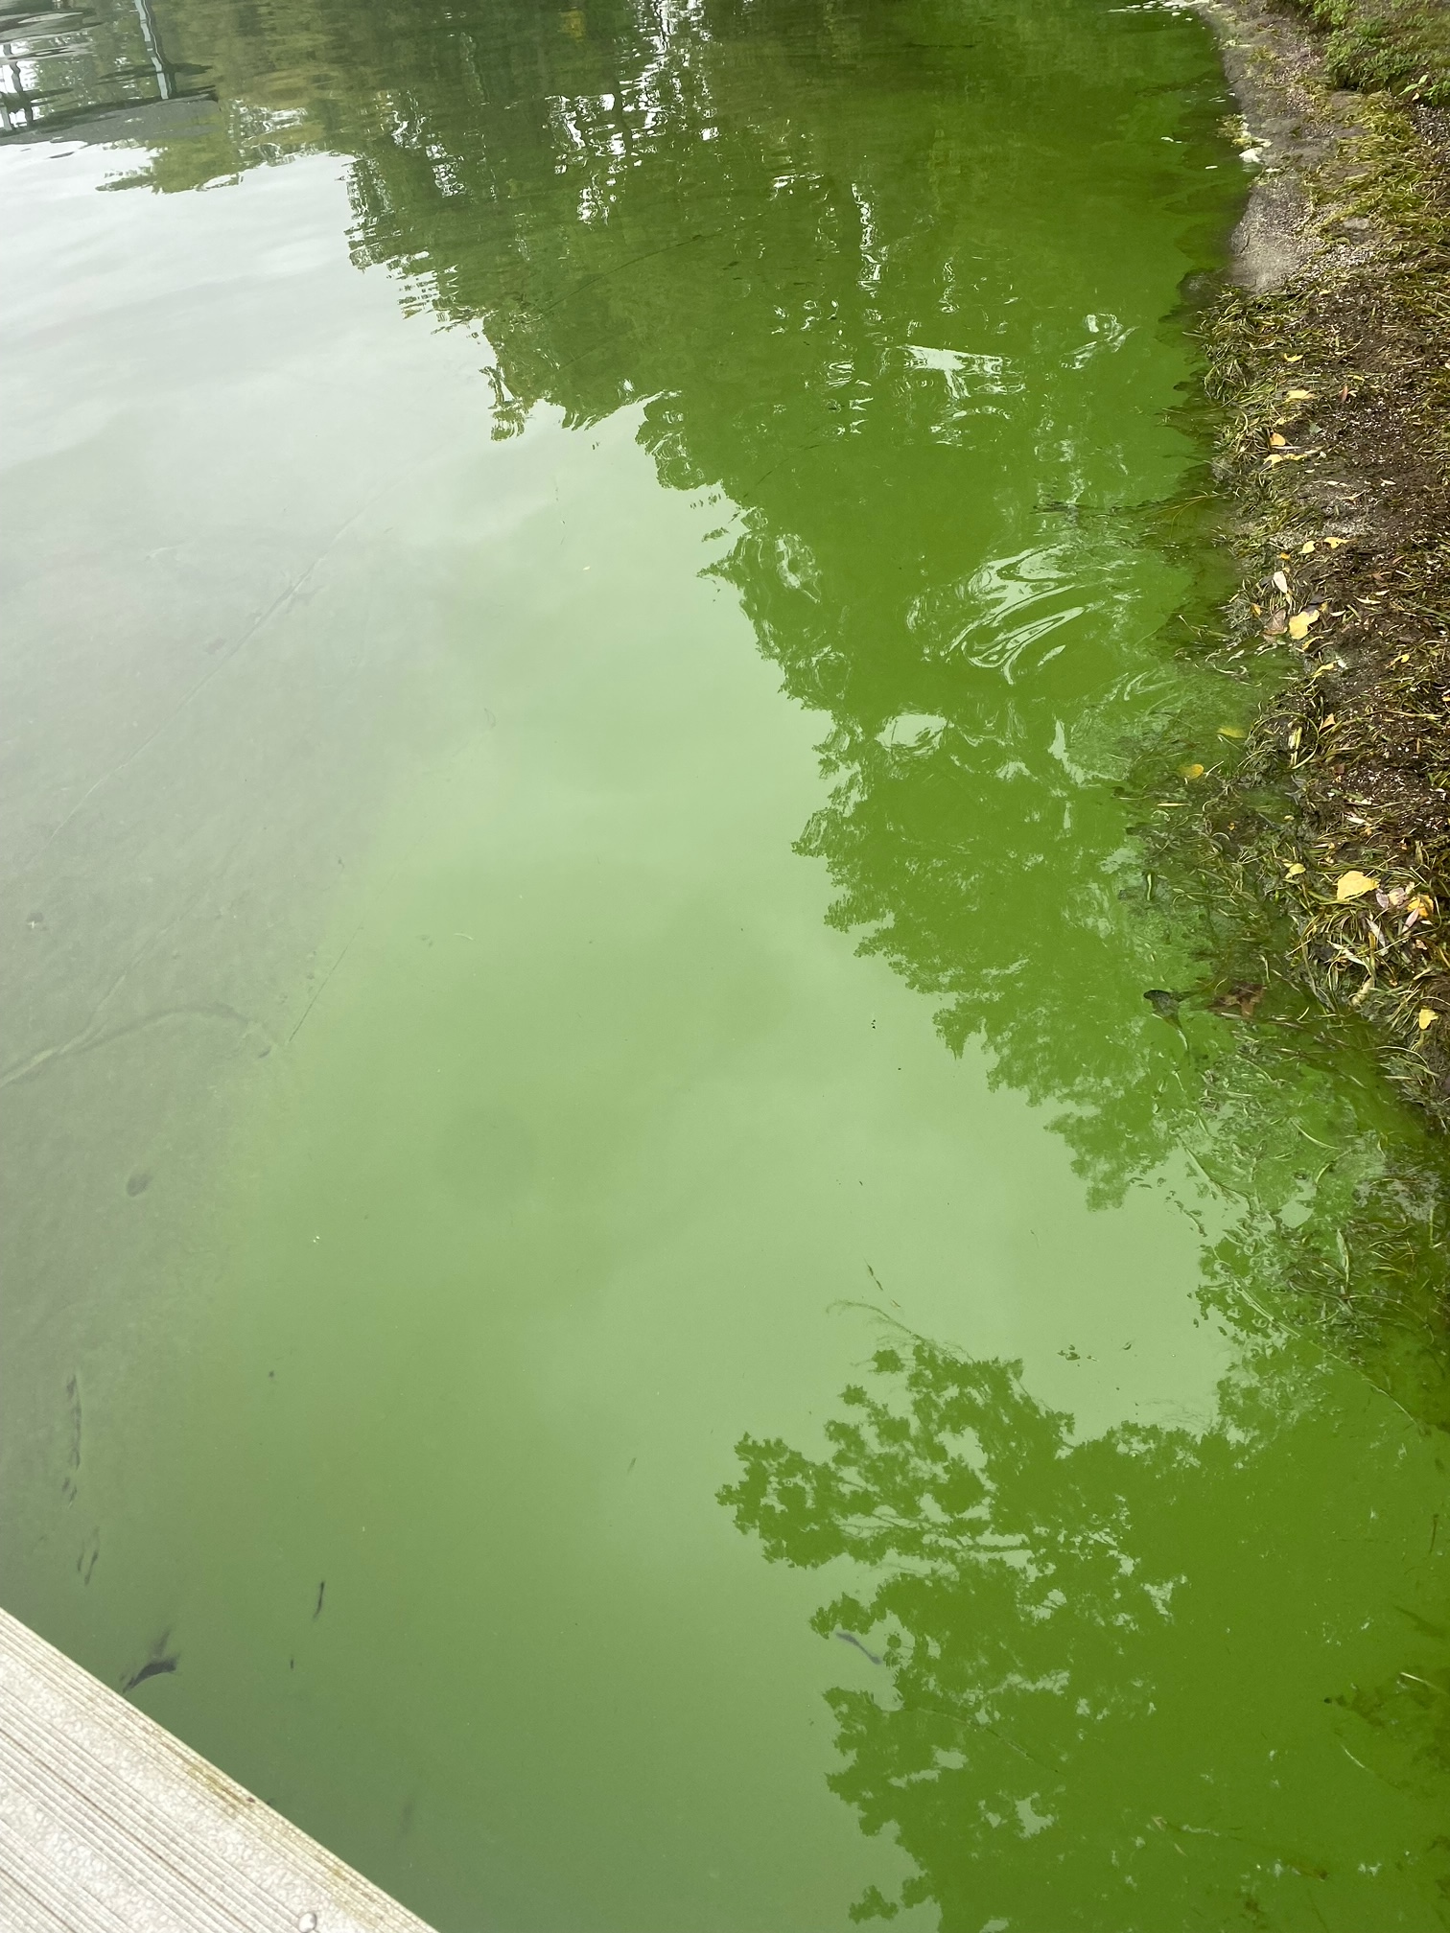
Test Your Skills
What is a Harmful Algal Bloom?
Reporting HABs
Identifying HABs

Slide 22
Test Your Skills
Yes
What is a Harmful Algal Bloom?
Reporting HABs
Identifying HABs

Slide 23
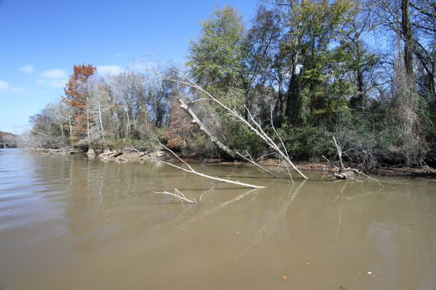
Test Your Skills
What is a Harmful Algal Bloom?
Reporting HABs
Identifying HABs

Slide 24
Test Your Skills
No
What is a Harmful Algal Bloom?
Reporting HABs
Identifying HABs

Slide 25
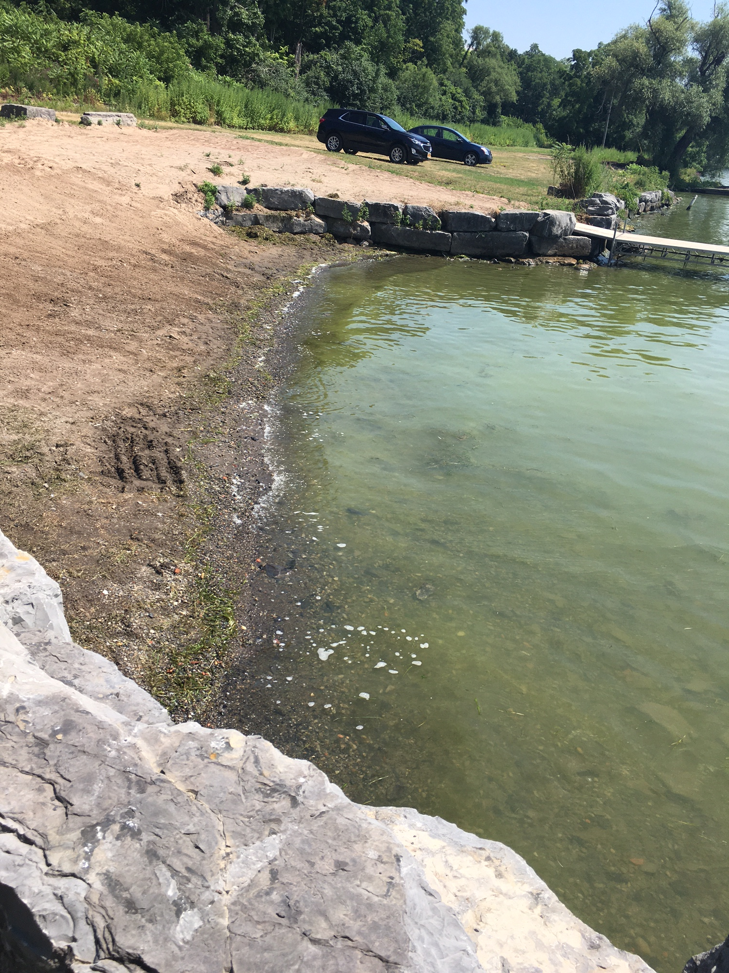
Test Your Skills
What is a Harmful Algal Bloom?
Reporting HABs
Identifying HABs

Slide 26
Test Your Skills
Yes
What is a Harmful Algal Bloom?
Reporting HABs
Identifying HABs

Slide 27
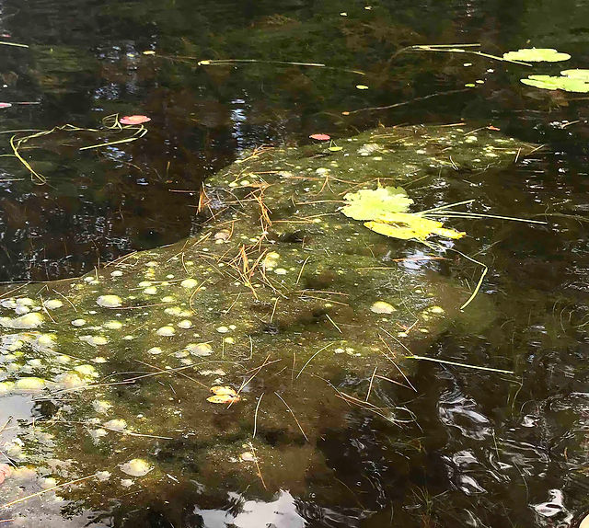
Test Your Skills
What is a Harmful Algal Bloom?
Reporting HABs
Identifying HABs

Slide 28
Test Your Skills
No
What is a Harmful Algal Bloom?
Reporting HABs
Identifying HABs

Slide 29
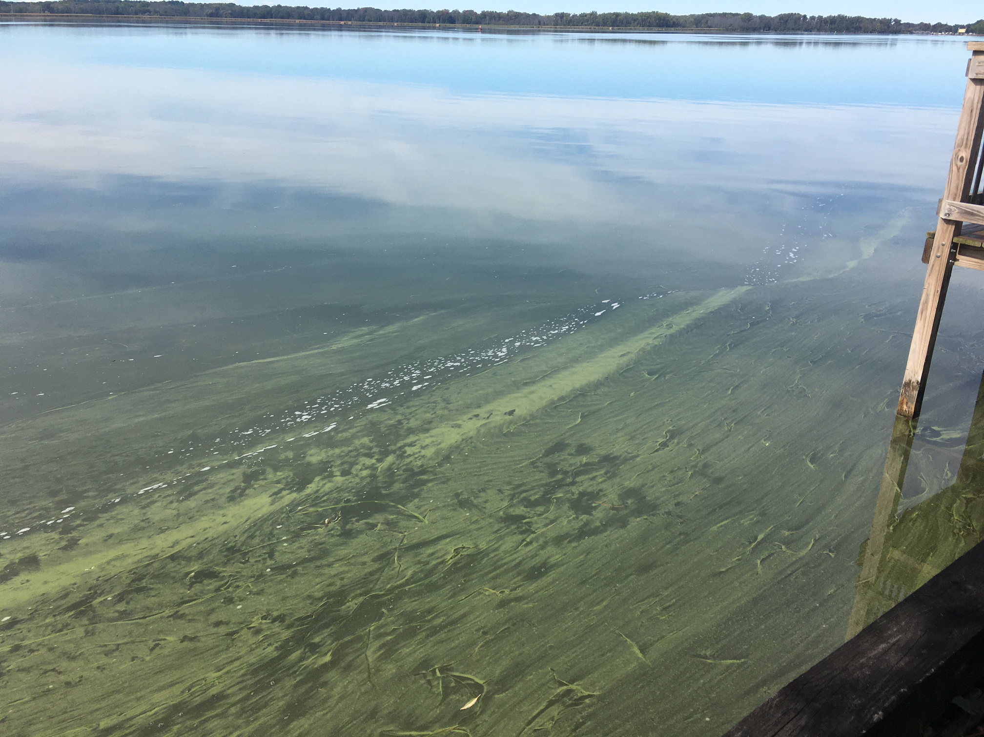
Test Your Skills
What is a Harmful Algal Bloom?
Reporting HABs
Identifying HABs

Slide 30
Test Your Skills
Yes
What is a Harmful Algal Bloom?
Reporting HABs
Identifying HABs

Slide 31
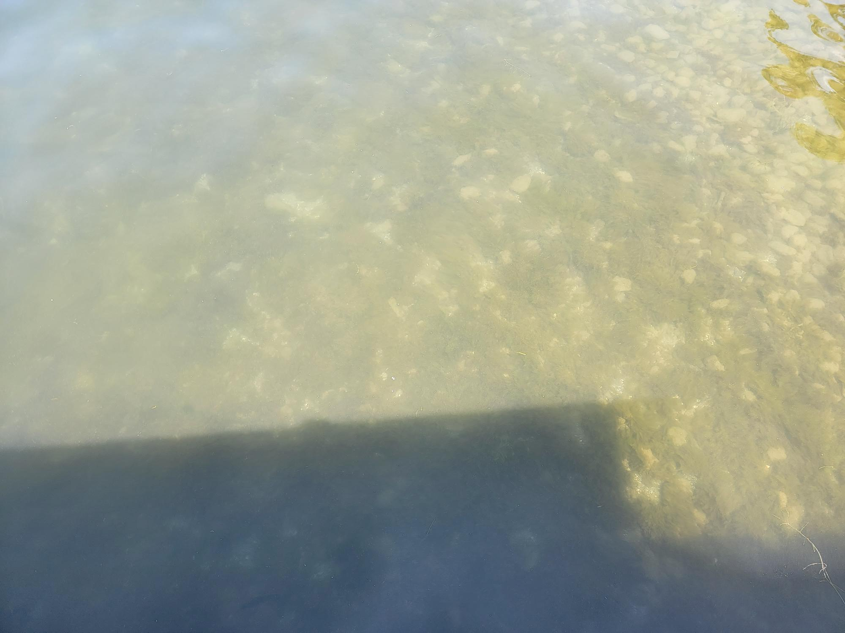
Test Your Skills
What is a Harmful Algal Bloom?
Reporting HABs
Identifying HABs

Slide 32
Test Your Skills
Maybe?
What is a Harmful Algal Bloom?
Reporting HABs
Identifying HABs

Slide 33
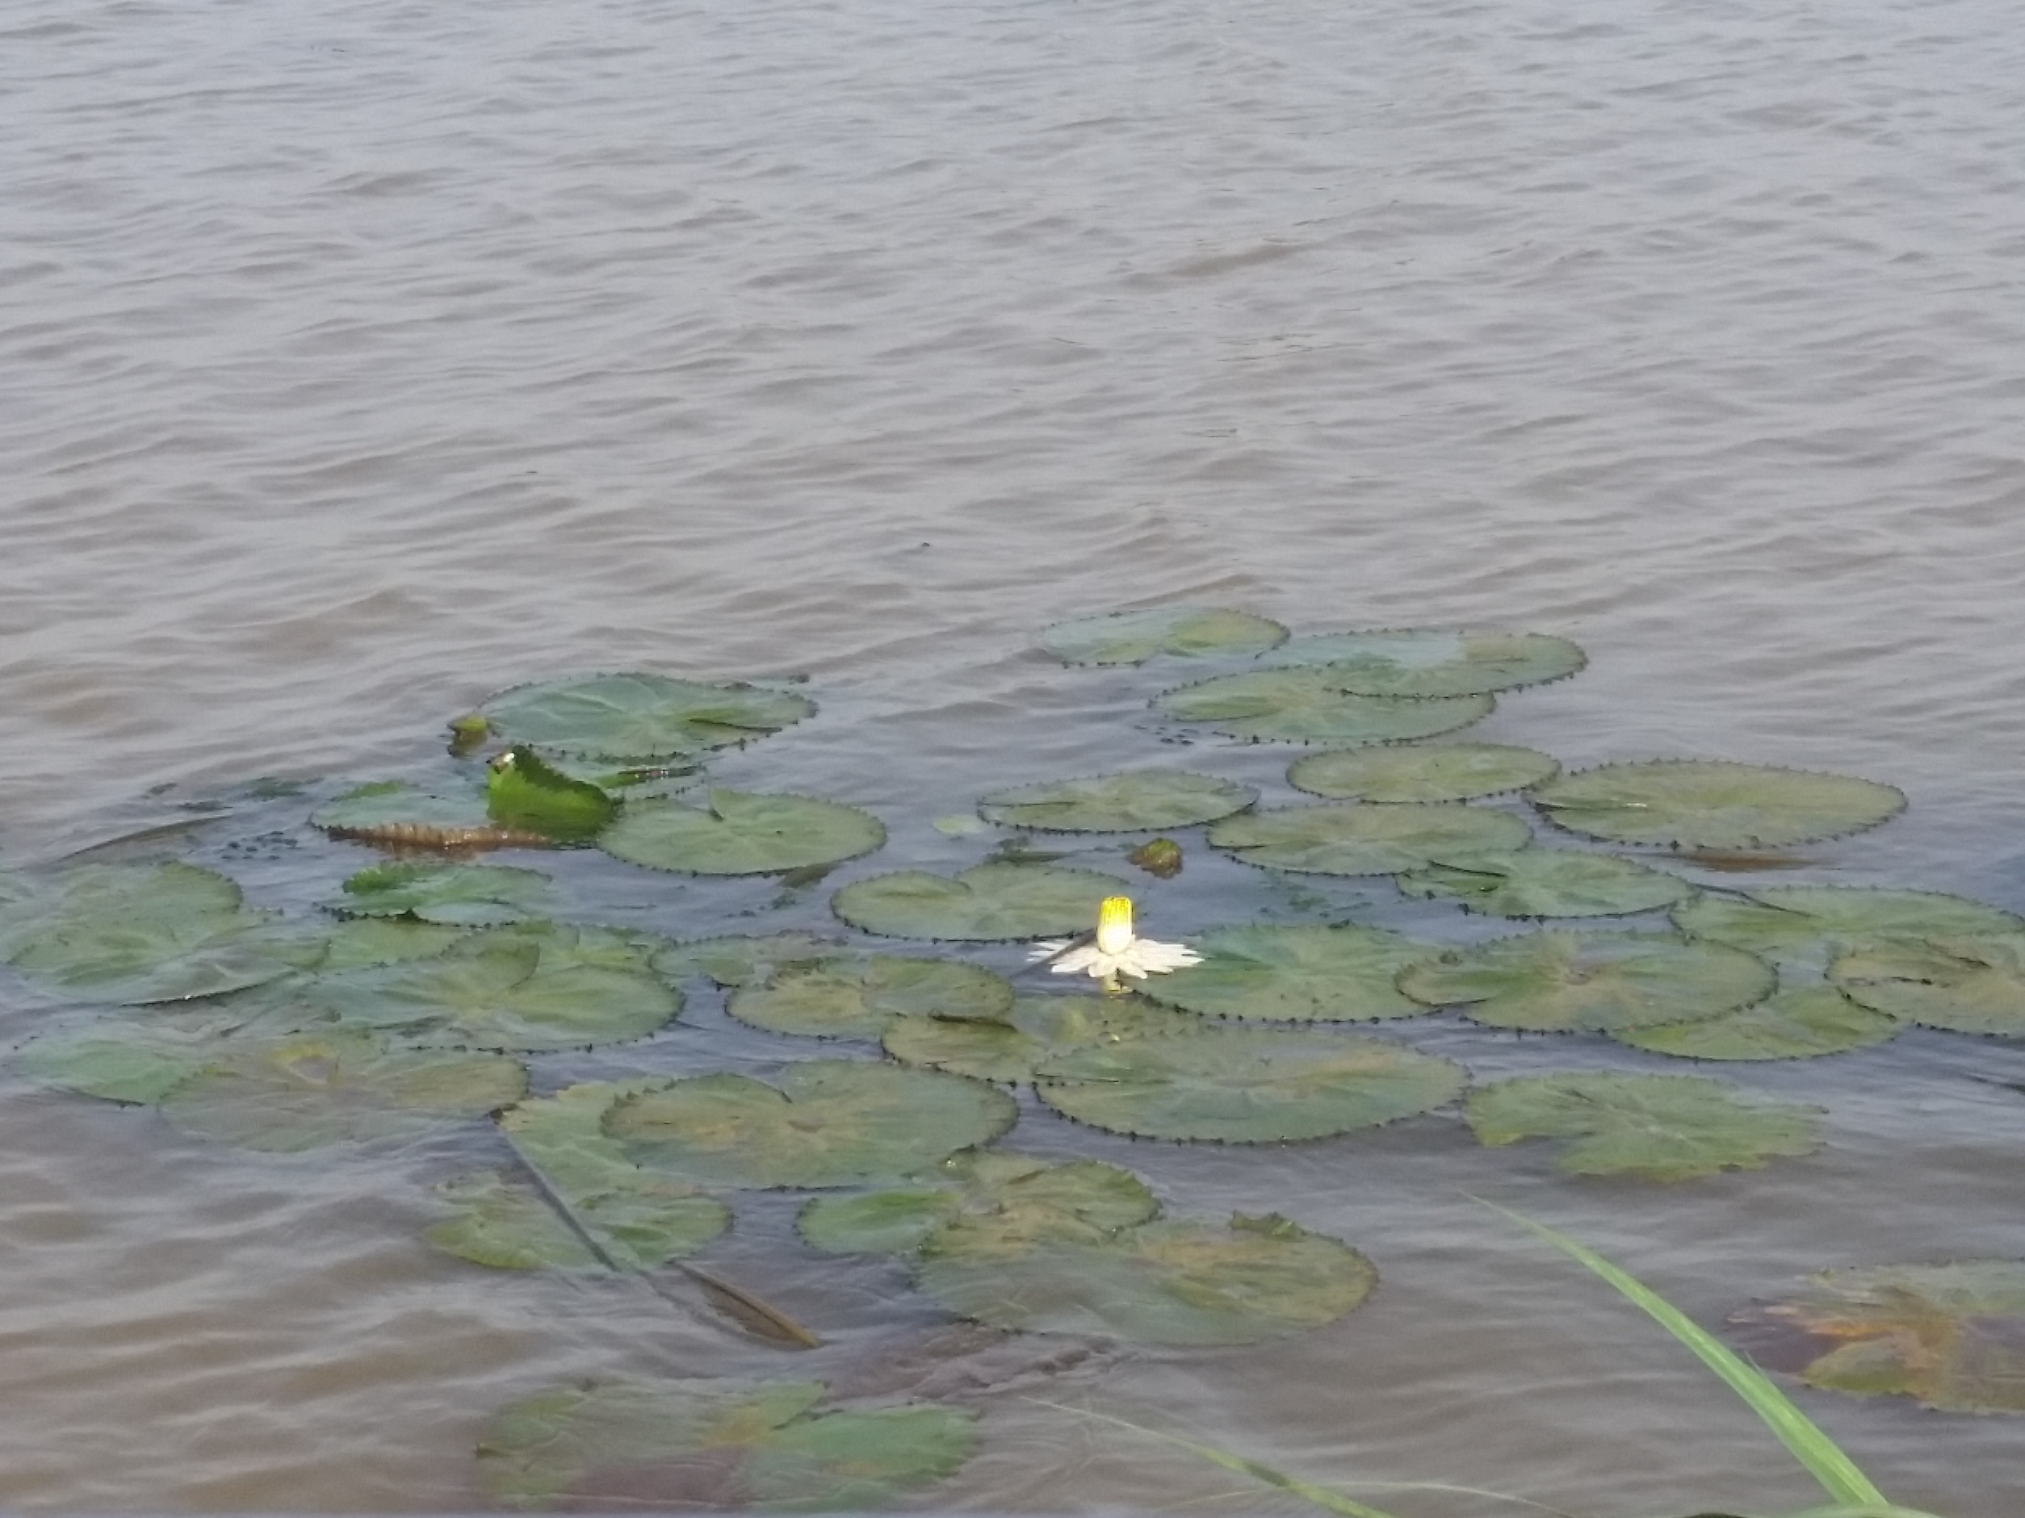
Test Your Skills
What is a Harmful Algal Bloom?
Reporting HABs
Identifying HABs

Slide 34
Test Your Skills
No
What is a Harmful Algal Bloom?
Reporting HABs
Identifying HABs

Slide 35
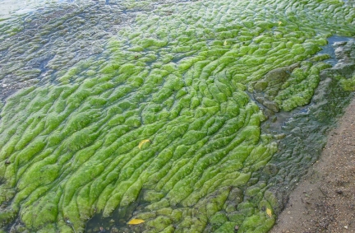
Test Your Skills
What is a Harmful Algal Bloom?
Reporting HABs
Identifying HABs

Slide 36
Test Your Skills
No
What is a Harmful Algal Bloom?
Reporting HABs
Identifying HABs

Slide 37
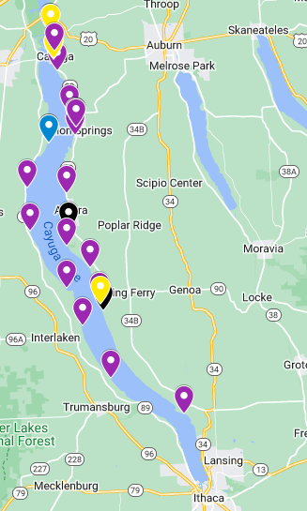



Cayuga Lake HABs Monitoring Program
CSI’s publicly available Cayuga Lake HABs map – updated in real time
  Began in 2018
  Purpose is twofold:
    Provide timely public health information on HABs on Cayuga Lake
    Collect data on trends in HAB formation and characteristics on Cayuga Lake to further scientific understanding
What is a Harmful Algal Bloom?
Reporting HABs
Identifying HABs
Notes:
So we’ve established that HABs are dangerous and we all know now how to identify them. Now we’ll talk nuts and bolts of the program.
CLHABMP started in 2018 in response to broad concern in this area about harmful algal blooms
This is a partnership!
Goals are to provide real-time data on HABs to local communities and municipalities about where and when HABs occur, and to continuously collect data on HABs trends on Cayuga Lake
Twofold purpose:
Map shows public health info, we know that many people in the area refer to this map to see where there currently are and aren’t HABs
As for scientific research, data collected through this program is currently being used in a scientific publication that is in review
Health Depts are also dependent on this data
It’s hard to see the numbers for HABs every summer and not feel discouraged, so I’m sharing this with you all so you know this data is going somewhere and being used.
This map shows the map we’ve used in the past, but this year it’s going to be a little different – I’ll get into that in a moment

Slide 38
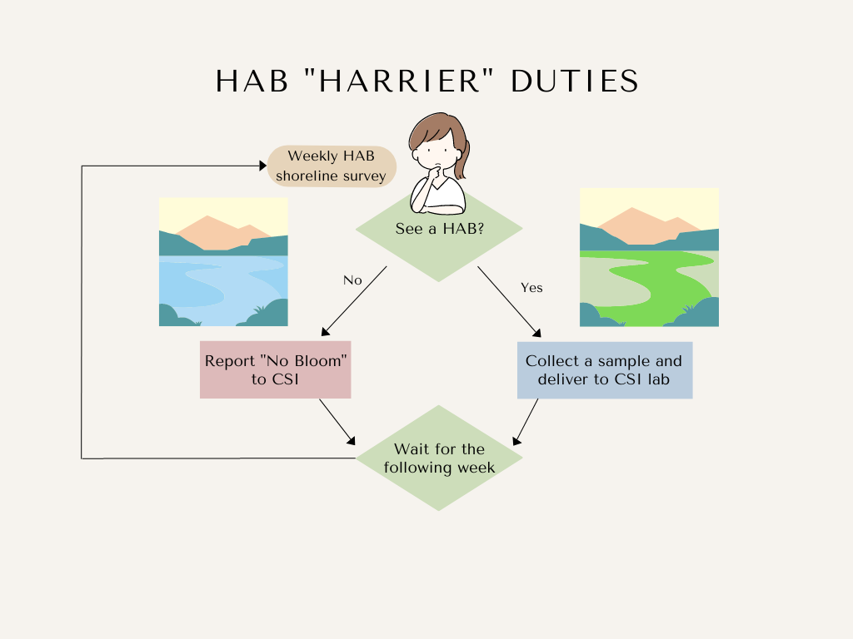
Note: “harrier” comes from the verb harry, to harass or attack repeatedly. As in “a harrier hawk attacks small game.” This term was applied to our HABs volunteers to describe their vigilance.
What is a Harmful Algal Bloom?
Reporting HABs
Identifying HABs
Notes:
Now we’ll get into how it works:
So each of you, HABs Harriers, are assigned a stretch of shoreline called your “zone”. If you do not yet have an assigned shoreline, I will get in touch with you next week to establish where you’ll monitor weekly.
Simply put, your duties are to survey your zone weekly and report back to CSI.

Slide 39
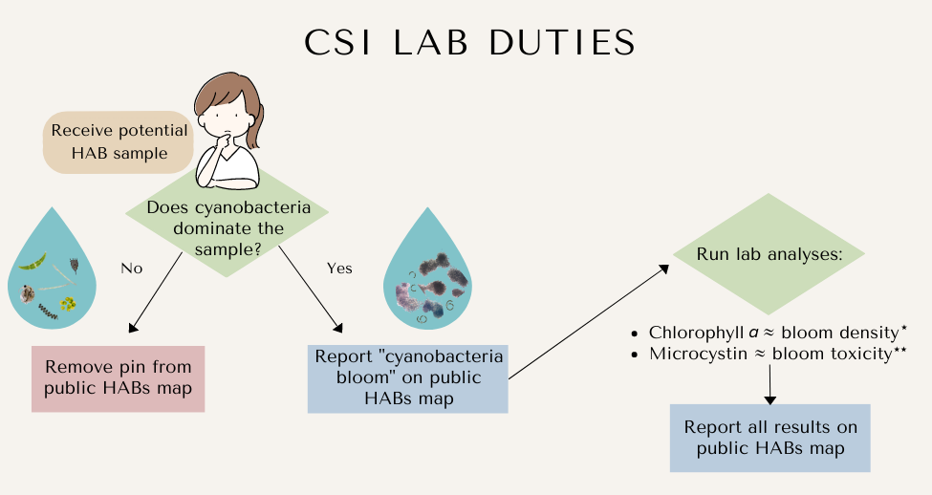
*Chlorophyll a can stem from organisms besides cyanobacteria, making this a rough estimate of bloom density
**Microcystin is only one of the possible cyanotoxins generated by cyanobacteria. It is a measure of toxicity from microcystin toxin, not of toxicity overall
What is a Harmful Algal Bloom?
Reporting HABs
Identifying HABs
Notes:
Once a bloom reaches our laboratory, we follow our own process:

Slide 40
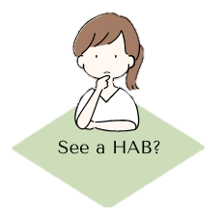
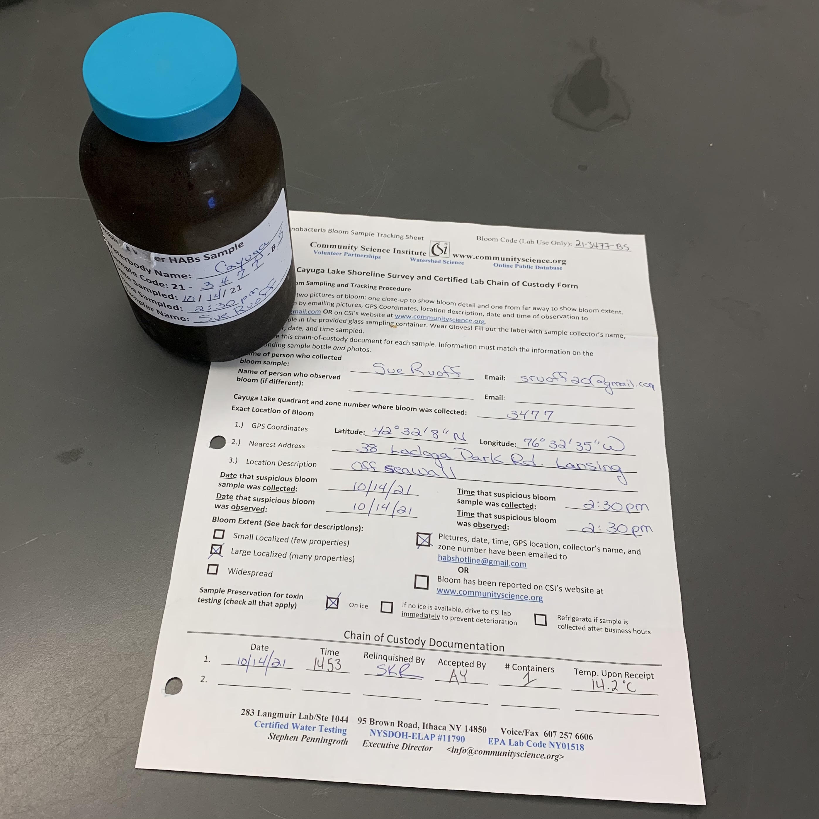



How to Monitor for HABs
  Survey your shoreline weekly from:
  July 1 – September 31
HABs sampling kit
What is a Harmful Algal Bloom?
Reporting HABs
Identifying HABs
Notes:
The HABs season on Cayuga Lake typically starts in July and lasts through the end of September. So within that time, you commit to surveying your zone weekly.
That could look like kayaking the length of your zone, walking the length of your zone, if you have some other approach and it gets you to lay eyes on your whole zone, that works too!
When you go out to do your weekly survey, you’ll want to bring your sampling kit with you (which we will hand out today) in case you do see a bloom.

Slide 41
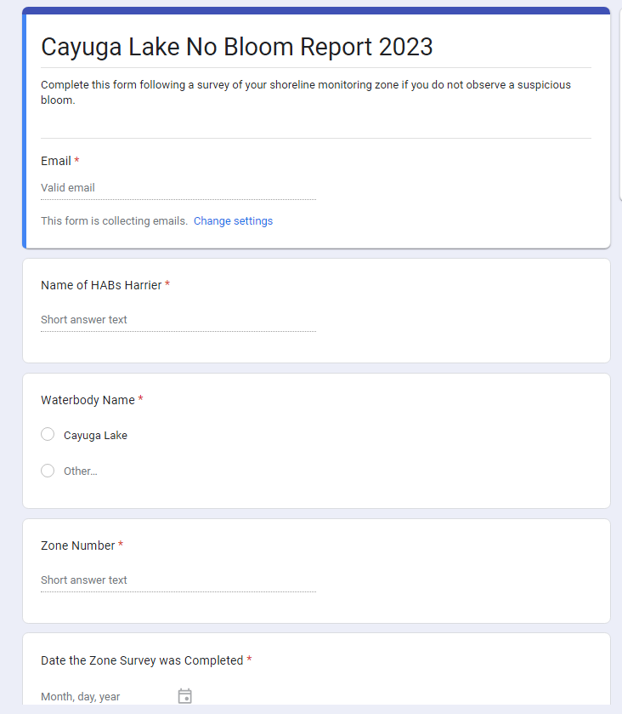
How to Monitor for HABs
  Report back to CSI
  If you do not see a bloom, complete our No Bloom Report
What is a Harmful Algal Bloom?
Reporting HABs
Identifying HABs
Notes:
If you don’t see a bloom, we ask that you submit a “No Bloom Report” once a week if you can. A LOT of people forget this every year, but it is really good information to have for us!
First, it tells us that you are all actually looking at your shorelines every week. A lack of no bloom reports can help us figure out where maybe some more support is needed – if a few weeks go by and I don’t hear anything from you, I might reach out to see how is this going for you? Do you need any additional support?
Second, it means if you do report a bloom, we have a bit better timeline for when it appeared. If you send in a no bloom report to me on Saturday and then report a bloom on Monday, it means we have hard data that that bloom began in the past 2 days.
I will send out a link with weekly reminder emails so they can always find it
We also encourage them to bookmark it
This will have things like observations, time, date, zone number, etc.

Slide 42
How to Monitor for HABs
  If you do see a bloom:
Take photos
Collect a sample
Fill out paperwork
Get that sample to CSI!
What is a Harmful Algal Bloom?
Reporting HABs
Identifying HABs
Notes:
If you DO see a bloom, there are a few

Slide 43
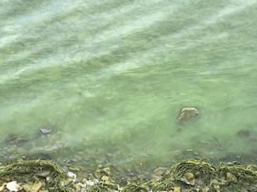
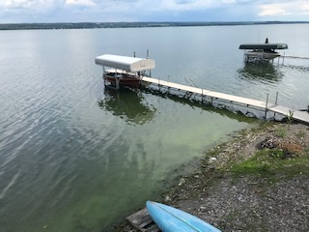
HABs Photos
  Close up
Far away
What is a Harmful Algal Bloom?
Reporting HABs
Identifying HABs
Notes:
If you DO see a bloom, there are a few

Slide 44
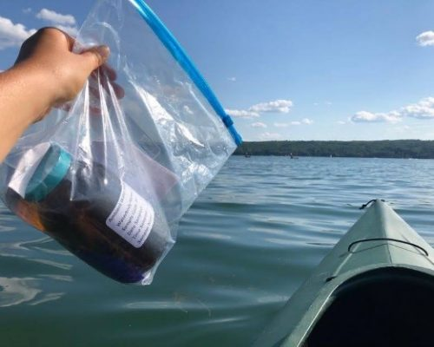
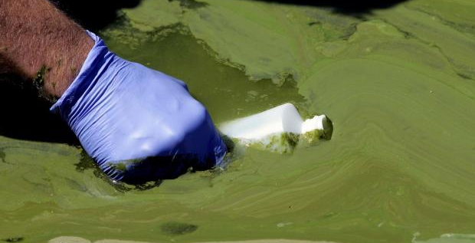
Collect a sample
Label the bottle first
Wear gloves!
Sample the densest part of the bloom
Keep the sample on ice
What is a Harmful Algal Bloom?
Reporting HABs
Identifying HABs
Notes:
Your sampling kit has three things in it:
a bottle to collect the sample in – it’s important to use this specific bottle that we give you; it’s made of amber glass and that goes into the certification of these results; the results are not certified if the sample is collected in a different bottle than the one we give you
Then it has gloves and this sheet of paper that we call a “tracking sheet” or “chain of custody”

Slide 45
Collect a sample
Ambient Water HABs Sample
Waterbody Name: _____________________
Sample Code: 23 - ___ ___ ___ ___ - B __
Date Sampled: __ / __ / 23
Time Sampled: __________
Sampler Name: _______________________
Label the bottle first
Wear gloves!
Sample the densest part of the bloom
Keep the sample on ice
Cayuga Lake
5
3 4
4 7
1
6 5
7:00pm
Grace Haynes
What is a Harmful Algal Bloom?
Reporting HABs
Identifying HABs
Notes:
Your sampling kit has three things in it:
a bottle to collect the sample in – it’s important to use this specific bottle that we give you

Slide 46

Collect a sample
Label the bottle first
Wear gloves!
Sample the densest part of the bloom
Keep the sample on ice
What is a Harmful Algal Bloom?
Reporting HABs
Identifying HABs
Notes:
This will protect your skin from the bloom – making contact with a HAB without gloves on can results in skin irritation, so these gloves will prevent that. No double dipping! Only one pass through the bloom, filled to the neck of the bottle.

Slide 47
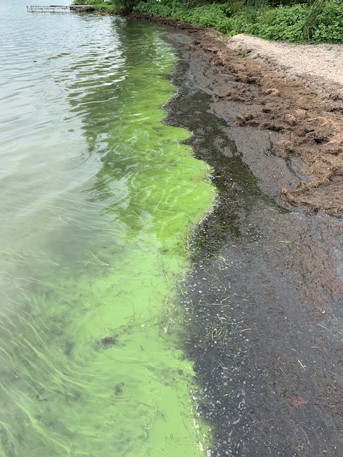
Collect a sample
Label the bottle first
Wear gloves!
Sample the densest part of the bloom
Keep the sample on ice
What is a Harmful Algal Bloom?
Reporting HABs
Identifying HABs
Notes:
No double dipping! Only one pass through the bloom, filled to the neck of the bottle. Do not make multiple passes as this will artificially concentrate the sample.

Slide 48

Collect a sample
Label the bottle first
Wear gloves!
Sample the densest part of the bloom
Keep the sample on ice
What is a Harmful Algal Bloom?
Reporting HABs
Identifying HABs
Notes:
As soon as you get home, put it in your fridge, when you’re transporting it (which we’ll talk about more soon), keep it in a cooler on ice.

Slide 49

Bloom Report (paperwork)
GPS Coordinates
Description
Date and time of collection
Bloom Extent
What is a Harmful Algal Bloom?
Reporting HABs
Identifying HABs
Notes:
So we’ve written on the bottle, we’ve collected the sample with our gloves. The last thing in the kit is this paperwork, which we call a “tracking sheet”
Some of the info you’ll fill out on this sheet is data on HABs that we’ll end up posting on the HABs page (which will be on the database now)
Other info you’ll fill out has to do with CSI’s laboratory certification. Basically, for us to be certified, we have to be able to account for that sample from the moment when it’s collected all the way through the end of its testing. This sheet helps us account for where it’s been before it reaches our lab
Most of this is pretty self-explanatory, but we’ll go through it together anyway for those of you who are new.
The top part here is your name and contact information if you are the one who collected the bloom

Slide 50
Bloom Report (paperwork)
GPS Coordinates
Cayuga Lake quadrant and zone number where bloom was collected: _____________
Exact Location of Bloom
GPS Coordinates Latitude: _______________ Longitude: ____________
Nearest Address ____________________________________________
What is a Harmful Algal Bloom?
Reporting HABs
Identifying HABs
Notes:
This is your zone number – IF YOU DO NOT ALREADY HAVE A ZONE NUMBER, I WILL BE IN TOUCH WITH YOU IN THE NEXT FEW WEEKS to assign one
Next, we’d like you to put the GPS coordinates if at all possible. If this is not possible, you can instead put in the nearest street address and we will approximate it on our end.

Slide 51



Bloom Report (paperwork)
GPS Coordinates - smartphone
If you have an iPhone
If you do NOT have an iPhone
1. Open www.google.com/maps
2. Double-click a spot on the map.
1. Open the “Compass” app
2. This is where the GPS coordinates of your current location is shown.
3. GPS Coordinates of the point will pop up below.
What is a Harmful Algal Bloom?
Reporting HABs
Identifying HABs
Notes:
If you have a smartphone, these are two good ways to find coordinates. If you do NOT have a smartphone, simply writing down the nearest address will work. Or, photos on smartphones will usually have metadata including GPS coordinates.

Slide 52
Bloom Report (paperwork)
Description, Date & Time
GPS Coordinates Latitude: _______________ Longitude: ____________
Nearest Address ____________________________________________
Location Description _____________________________________
  Date that suspicious bloom
  sample was collected:
  Date that suspicious bloom
  sample was observed:
  Time that suspicious bloom
  sample was collected:
  Time that suspicious bloom
  sample was observed:
What is a Harmful Algal Bloom?
Reporting HABs
Identifying HABs
Notes:
You can describe any features in the water here, like “in a cove” or “next to the dock”; it’s also a good place to put any additional descriptions of the bloom itself – is it clustered only right on the shore or can you see it 100 yards out?
Collect the date and time you collected the bloom, and the date and time it was observed if that’s a different time

Slide 53
Bloom Report (paperwork)
Bloom Extent
  Bloom Extent (See back for descriptions):
    Small Localized (few properties)
    Large Localized (many properties)
    Widespread
What is a Harmful Algal Bloom?
Reporting HABs
Identifying HABs
Notes:
Small Localized: Bloom affects a small area of the waterbody, limited from one to several neighboring properties.
Large Localized: Bloom affects many properties within an entire cove, along a large segment of shoreline, or in a specific region of the waterbody.
Widespread: Bloom affects the entire waterbody, a large portion of the lake, or most to all of the shoreline – if it’s as far as the eye can see
Then this part off to the right is to remind you that you need to send photos, date, time, and location to us at CSI, and that all gets into sample transportation.

Slide 54
Bloom Report (paperwork)
Bloom Extent
Chain of Custody Documentation
Date Time Relinquished By Accepted By
1. _______ _______ ________________ _____________
2. _______ _______ ________________ _____________
6/8/23
2:38pm
Shelley Meyer
Grace Haynes
What is a Harmful Algal Bloom?
Reporting HABs
Identifying HABs
Notes:
Small Localized: Bloom affects a small area of the waterbody, limited from one to several neighboring properties.
Large Localized: Bloom affects many properties within an entire cove, along a large segment of shoreline, or in a specific region of the waterbody.
Widespread: Bloom affects the entire waterbody, a large portion of the lake, or most to all of the shoreline – if it’s as far as the eye can see
Then this part off to the right is to remind you that you need to send photos, date, time, and location to us at CSI, and that all gets into sample transportation.

Slide 55
Sample Transport
CSI needs to receive the sample ASAP
You must contact the following about your bloom:
  Quadrant Leader
    NW Quadrant: Eileen Percevault
    NE Quadrant: STILL SEEKING QUADRANT LEADER
    SW Quadrant: Andy Yale and John Abel
    SE Quadrant: Glenn Ratajczak
  habshotline@gmail.com or communityscience.org/habreport
    Include photos, GPS coordinates, and date/time
Sample transportation depends on your quadrant
What is a Harmful Algal Bloom?
Reporting HABs
Identifying HABs
Notes:
This can be the trickiest part of the HABs sampling process, especially on the north end of the lake. Because

Slide 56

Sample Transport – SW and SE Quadrants
(SW – south of Sheldrake Point; SE – south of Elmwood Point)
After contacting habshotline@gmail.com or communityscience.org/habreport, Harriers in these two Quadrants should bring their samples to CSI’s laboratory at:
    Langmuir Lab, Room 283
    95 Brown Rd.
    Ithaca, NY 14850
Room 283 during business hours
(9am – 5pm M-F)
Or in the after-hours fridge
What is a Harmful Algal Bloom?
Reporting HABs
Identifying HABs

Slide 57
Sample Transport – NW Quadrant
After contacting habshotline@gmail.com or communityscience.org/habreport, contact:
  Eileen Percevault (973) 666-2221
  Ken Riemer (607) 279-9510
Drop your sample off at:
    6041 Lakeview Ln.
    Romulus, NY
(this is ¼ mile south of Dean’s Cove)
This is Ken’s home address. He has a Canada goose mailbox and a place to turn around – drive up his driveway to find a cooler and replacement kits
What is a Harmful Algal Bloom?
Reporting HABs
Identifying HABs

Slide 58
Sample Transport – NE Quadrant
After contacting habshotline@gmail.com or communityscience.org/habreport,
Drop your sample off ON ICE at:
    Village of Aurora Fire House
    456 Main St
    Aurora, NY 13026
There will be a cooler and replacement HABs sampling kits here.
What is a Harmful Algal Bloom?
Reporting HABs
Identifying HABs

Slide 59


HABs Analyses (in the lab)
1) Cyanobacteria composition
2) Total Chlorophyll a
3) Microcystin toxin
Microcystis sp.
Dolichospermum sp.
What is a Harmful Algal Bloom?
Reporting HABs
Identifying HABs
Notes:
This can be the trickiest part of the HABs sampling process, especially on the north end of the lake. Because

Slide 60


HABs Analyses (in the lab)
1) Cyanobacteria composition
2) Total Chlorophyll a
3) Microcystin toxin
This roughly corresponds to how dense a bloom is
Bloom levels > 25 µg/L (usually)
Microcystis sp.
Dolichospermum sp.
What is a Harmful Algal Bloom?
Reporting HABs
Identifying HABs

Slide 61
HABs Analyses (in the lab)
1) Cyanobacteria composition
2) Total Chlorophyll a
3) Microcystin toxin
0.3 µg/L = drinking water limit
4 µg/L = contact recreation limit
Limits were set by the EPA and are used by the NYSDOH
This roughly corresponds to how dense a bloom is
Bloom levels > 25 µg/L (usually)
Microcystis sp.
Dolichospermum sp.
It is NEVER safe to swim in a bloom! Always keep pets and children away from blooms!
What is a Harmful Algal Bloom?
Reporting HABs
Identifying HABs

Slide 62



Staying Up-To-Date
The Cayuga Lake HABs Reporting Page
CLWN Weekly Updates to the Public
DCL Sunday Community Cruises
New!
View on CSI’s website at www.communityscience.org
What is a Harmful Algal Bloom?
Reporting HABs
Identifying HABs

Slide 63
Staying Up-To-Date
Database
The Cayuga Lake HABs Reporting Page
CLWN Weekly Updates to the Public
DCL Sunday Community Cruises
New!
View on CSI’s website at www.communityscience.org
What is a Harmful Algal Bloom?
Reporting HABs
Identifying HABs

Slide 64

HABs Database
database.communityscience.org/hab
View all blooms reported:
Since 2018
Last 30 days
Last 2 weeks
Last 7 days
Notes:
Lakeshore Segment Northeast 1 for demonstration

Slide 65

We still need volunteers!
Notes:
Talk to your neighbors!

Slide 66




Any questions?
Learn more at: www.communityscience.org
Email us at info@communityscience.org to become a volunteer!
facebook.com/CommunityScience
instagram.com/CommunityScienceInstitute/
twitter.com/CSIwater
Notes:
Facebook Instagram twitter

