Slide 1
Cayuga Lake HABs in 2023

Slide 2
Quick Program Facts - 2023
Number of volunteers: 85 HABs Harriers; 8 HABs Carriers
Number of monitoring zones: 73
  HABs Zone Reference Map for distribution of coverage
We received HABs reports from June 22, 2023 – October 26, 2023

Slide 3
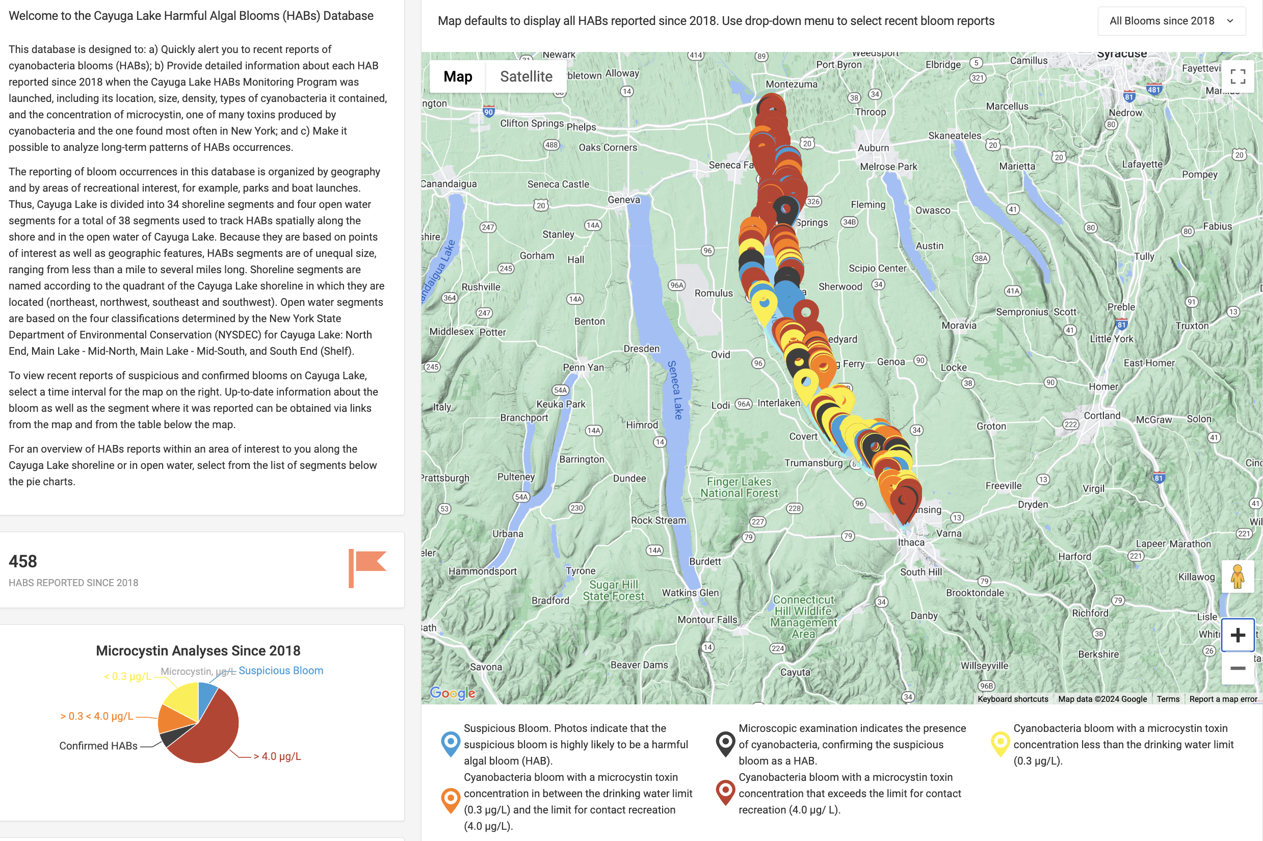
Debuted new HABs database thanks to funding by Tompkins County Health Department

Slide 4
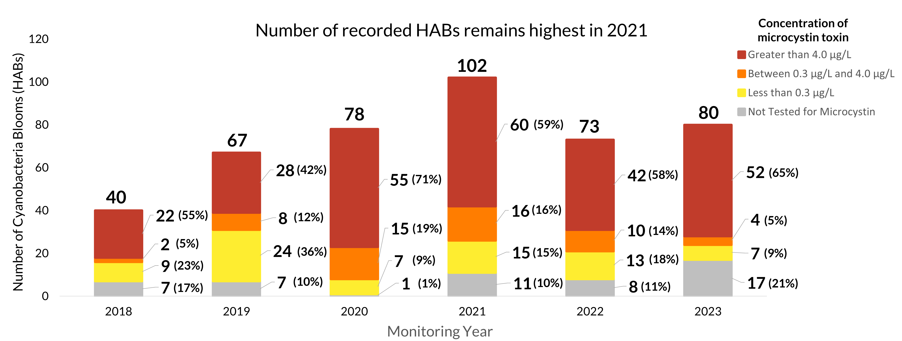
Number of reported HABs on Cayuga Lake and their corresponding microcystin concentration (2018-2023)
Main Takeaways:
- While HAB reports did not increase much in 2023 over 2022, 2023 HAB reports were much higher than 2018 and 2019.
- More than half of 2023 HAB samples had microcystin levels greater than 4.0 ug/L (contact recreation limit). This is consistent with past years.

Slide 5
Main Takeaways:
- In 2023, July had fewer HAB than any other year.
- In 2023, August generally had fewer HAB than other years (exception 2018 & 2019)
- In 2023, September had more HAB reports than any other year.
- In 2023, October had more HAB reports than any other year except 2021.
Disclaimer: Monitoring coverage is not as consistent in June and October compared to July - September

Slide 6
Main Takeaways:
-Since 2019, Cayuga County consistently has had the highest number of blooms reported each season.
- In 2023, Cayuga County had more HAB reports than Tompkins and Seneca County combined
- Tompkins County and Seneca County tend to have similar numbers of HAB reports.

Slide 7
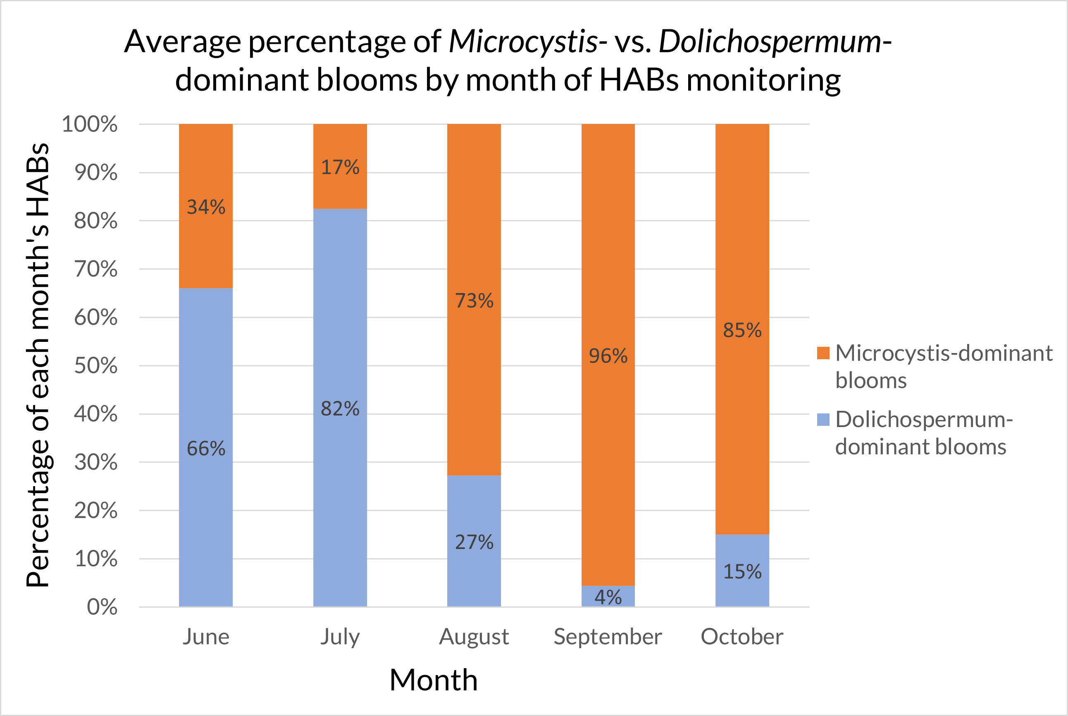
Main Takeaways:
- Earlier in the season (June-July), most blooms are dominated by Dolichospermum
- Later in the season (August – October), most blooms are dominated by Microcystis
- We have observed the trends above consistently each year since 2018
Note: This graph reflects HABs data from all six years of CSI’s Cayuga Lake HAB Monitoring Program

Slide 8
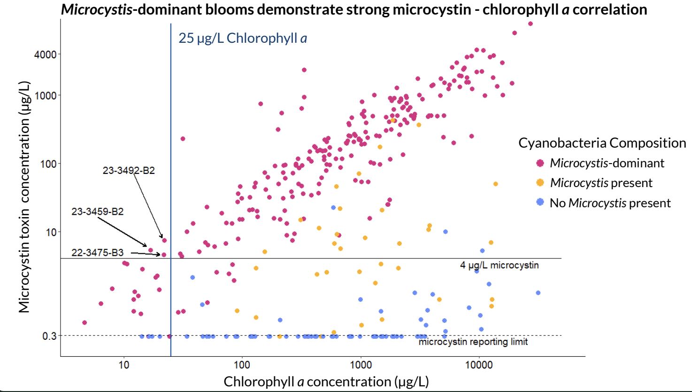
Main Takeaways:
- Blooms that are Microcystis-dominant usually have higher levels of microcystin toxin than blooms that are not Microcystis-dominant.
- There is a strong positive relationship between chlorophyll a and microcystin concentration in blooms that are Microcystis-dominant
- We have observed the trends above consistently each year since 2018
Note: This graph reflects HABs data from all six years of CSI’s Cayuga Lake HAB Monitoring Program

Slide 9
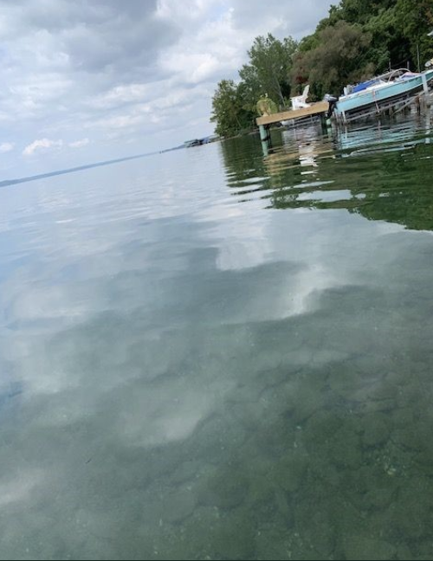
- DEC defines a bloom as having 25 ug/L chlorophyll a or greater
- In 2023, two blooms (one pictured above) had chlorophyll a concentrations less than 25 ug/L but exceeded contact recreation limit for microcystin. The same was true for one bloom in 2022. Just because a bloom appears sparse, does not necessarily mean the toxin levels are low.
Note: This graph reflects HABs data from all six years of CSI’s Cayuga Lake HAB Monitoring Program

Slide 10
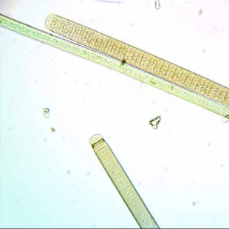
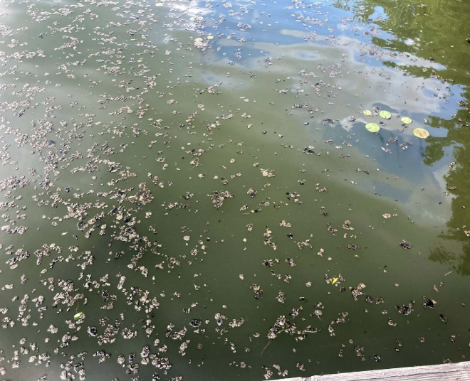
Benthic HABs – Order Oscillatoriales
- Found in Cayuga Inlet and Southern end of Cayuga Lake in 2022 and 2023
- The appearance of these clumps contradicts traditional HAB ID
- One sample was collected in 2023 and tested for a suite of toxins by Greg Boyer’s lab at SUNY ESF. All toxins were found to be non-detect.
CSI’s biomonitoring coordinator, Adrianna Hirtler, presented on this topic at the FLI Research Conference in January 2024.

Slide 11
Cayuga Lake HABs Monitoring in 2024

Slide 12
Cayuga Lake HABs Monitoring in 2024
Continue program as usual with the following modifications:
  Eliminate around the lake non-bloom sampling for phytoplankton communities
  Incorporate modified messaging to include benthic HABs.
    Some samples of benthic HABs will be sent to Gregg Boyer’s lab at SUNY ESF for more toxin testing.
From NYSDEC HABs page:

Slide 13
Questions
Is our program still addressing county priorities?
  Are cyanobacteria identification and microcystin and chlorophyll a testing still beneficial?
  What information is the most useful to you?
Are there any other directions that you would like to see us pursue in future years?
Do you have any other suggestions?

